Slide 1
2004 Cross-shelf
28/11/2019

Slide 2
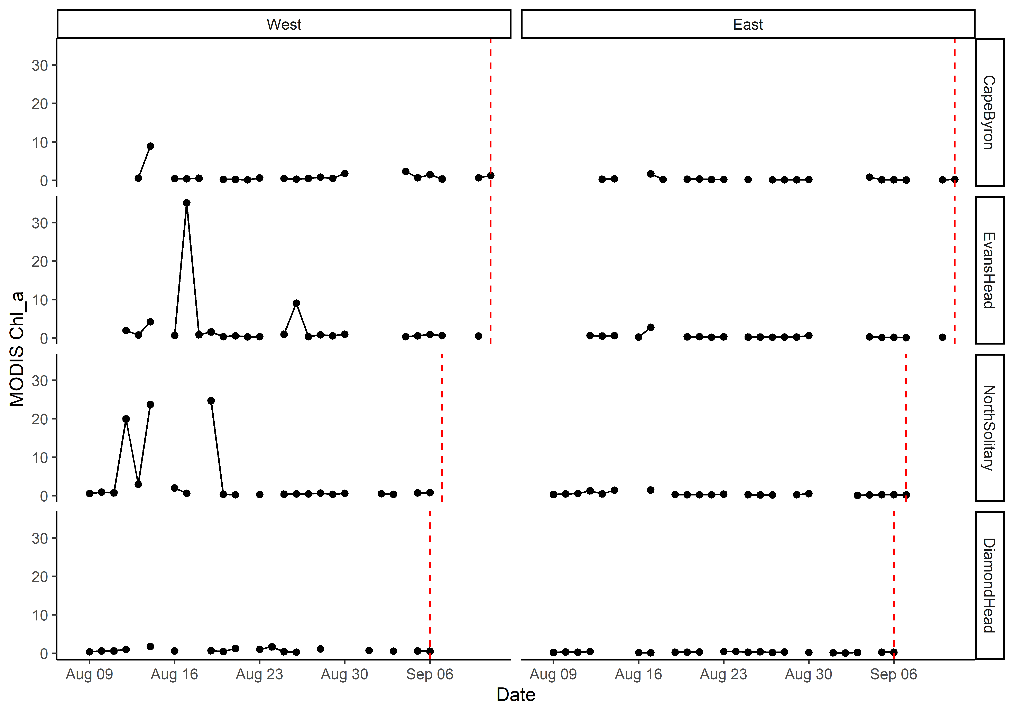
MODIS Chl_a

Slide 3
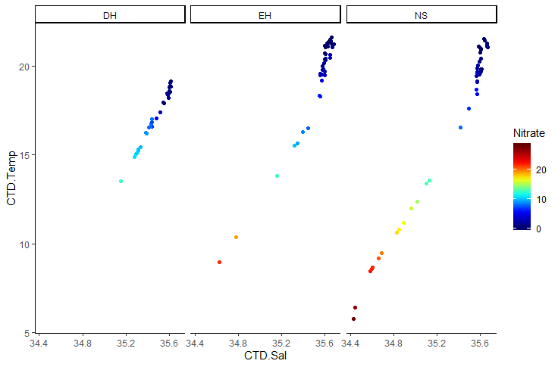
T-S Plot all depths (CTD)

Slide 4
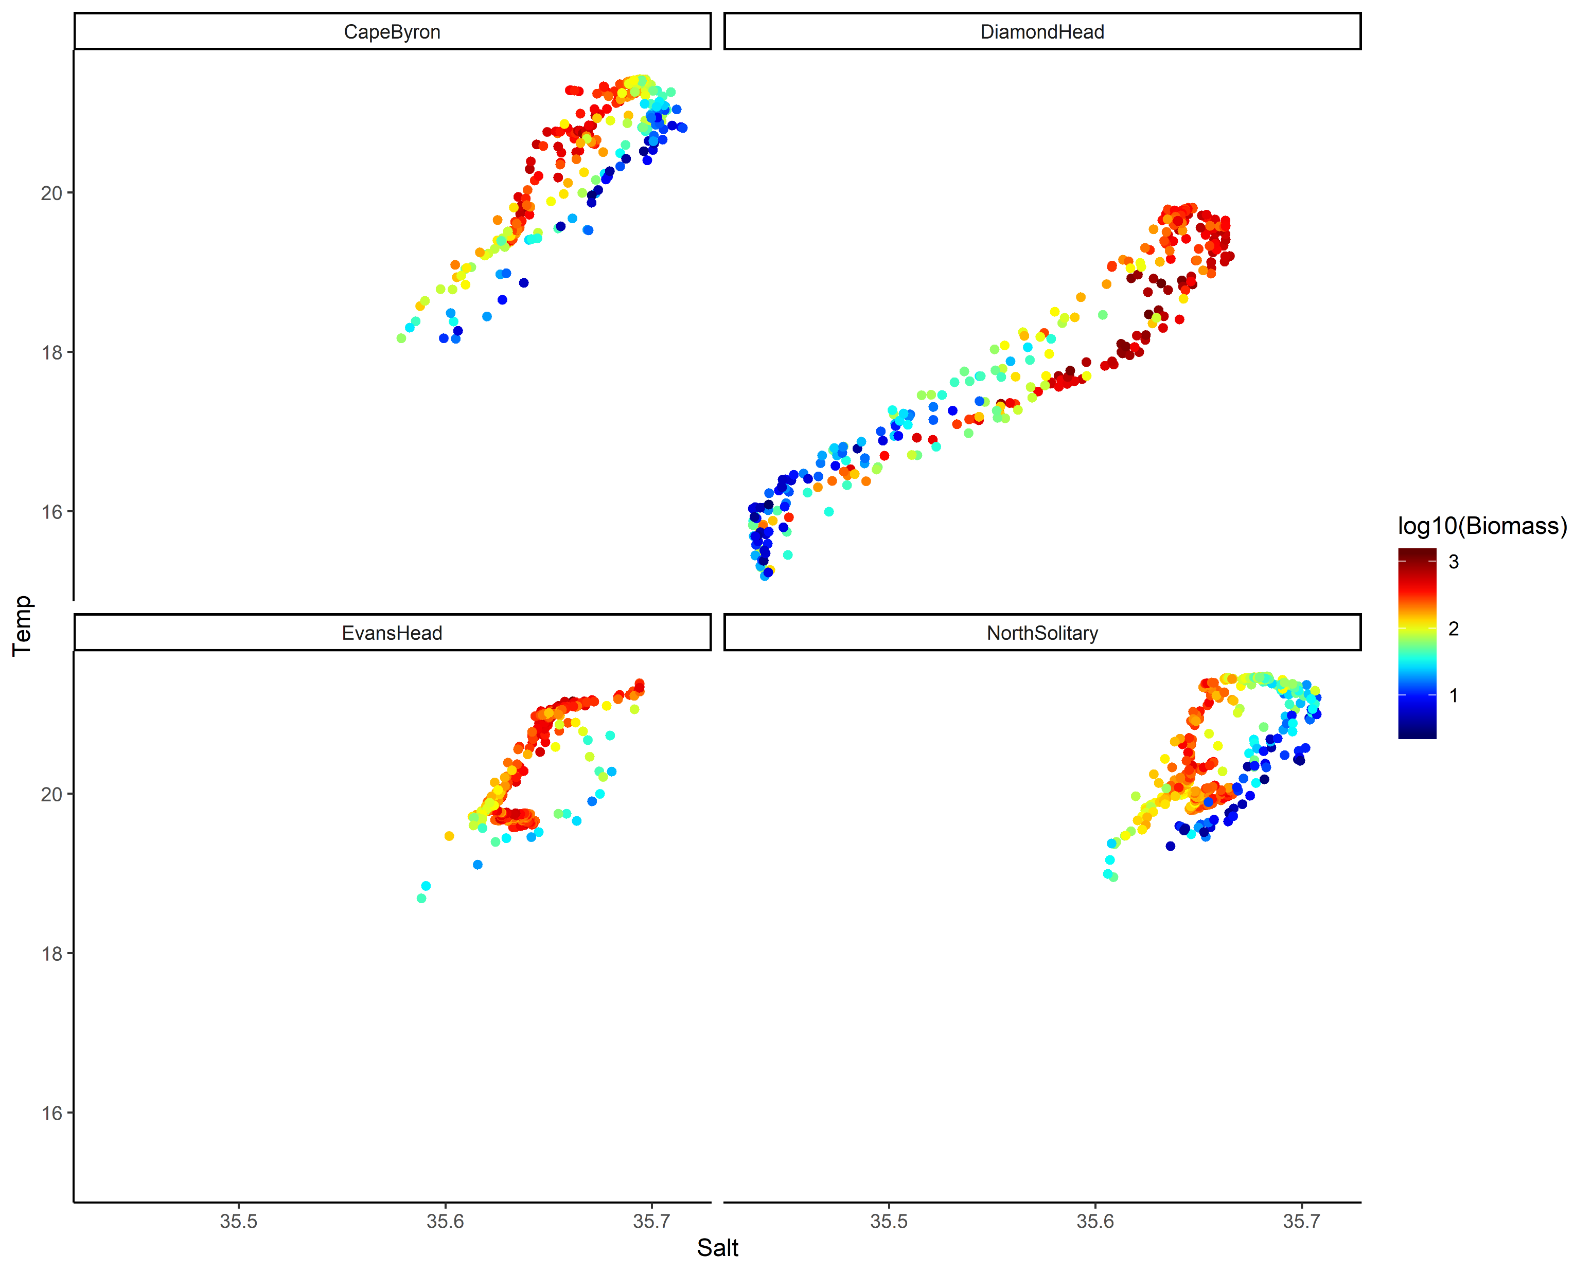
TS Plot by log₁₀(Biomass)

Slide 5
Key Questions
Aim: Describe the water and zooplankton characteristics across the East Australian shelf.
Water characteristics – physical oceanography
Zooplankton characteristics
Are they linked?
What is the larger context of these transects?

Slide 6
Water Characteristics
3 Transects go from inshore to EAC
Diamond Head is in a separation zone
See V-rotated velocities and Temperature
2 types of water mass, EAC influenced and separation zone
Compare northern 3 to Diamond Head

Slide 7
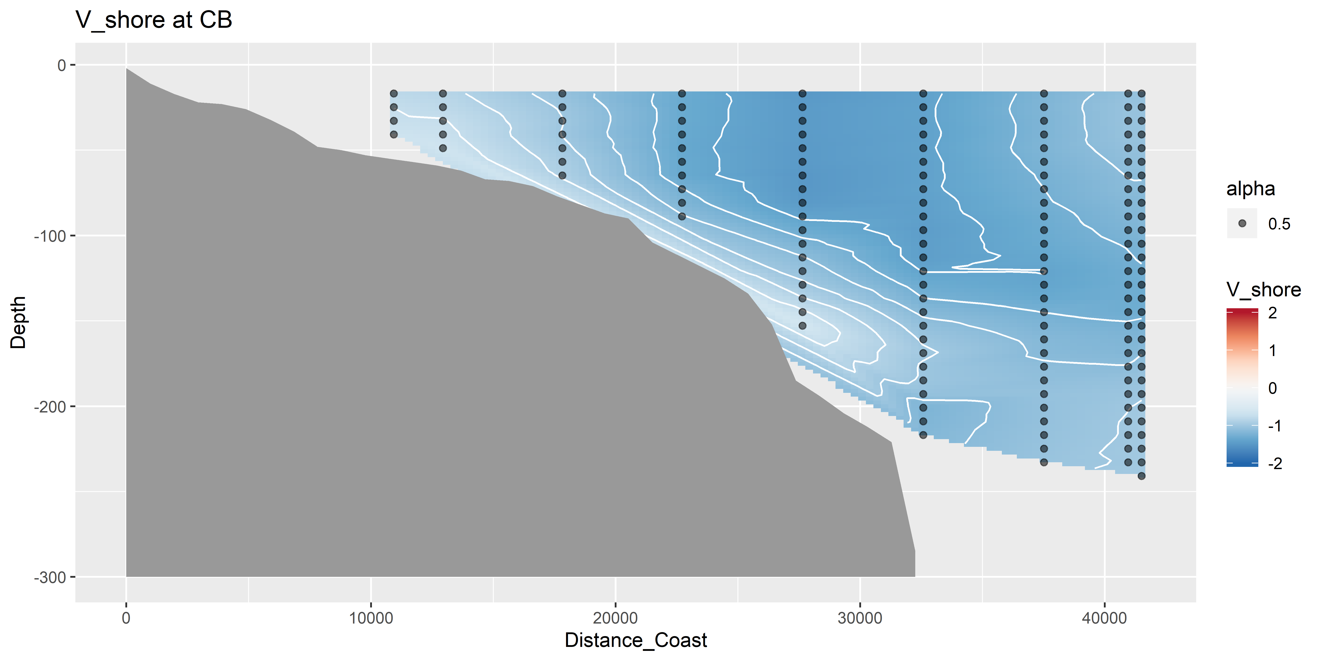
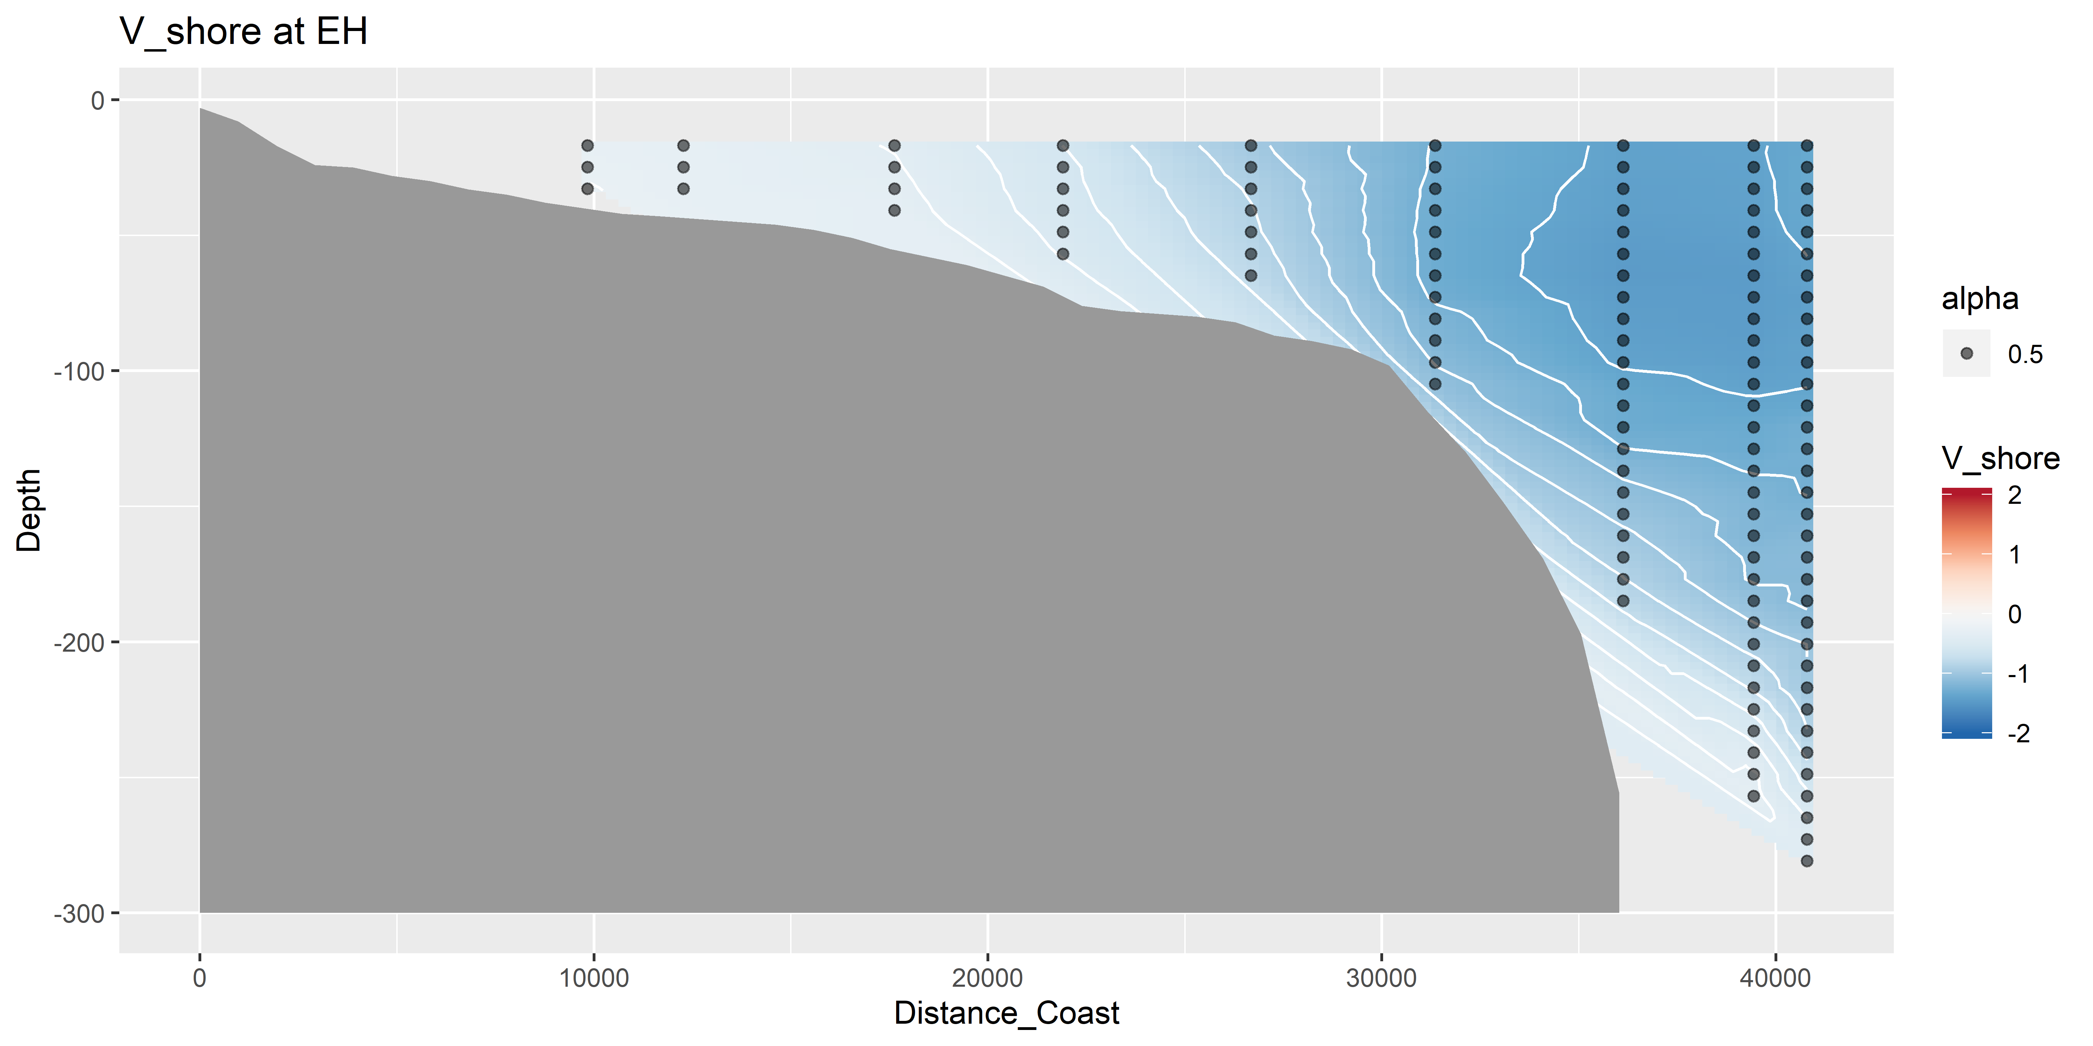
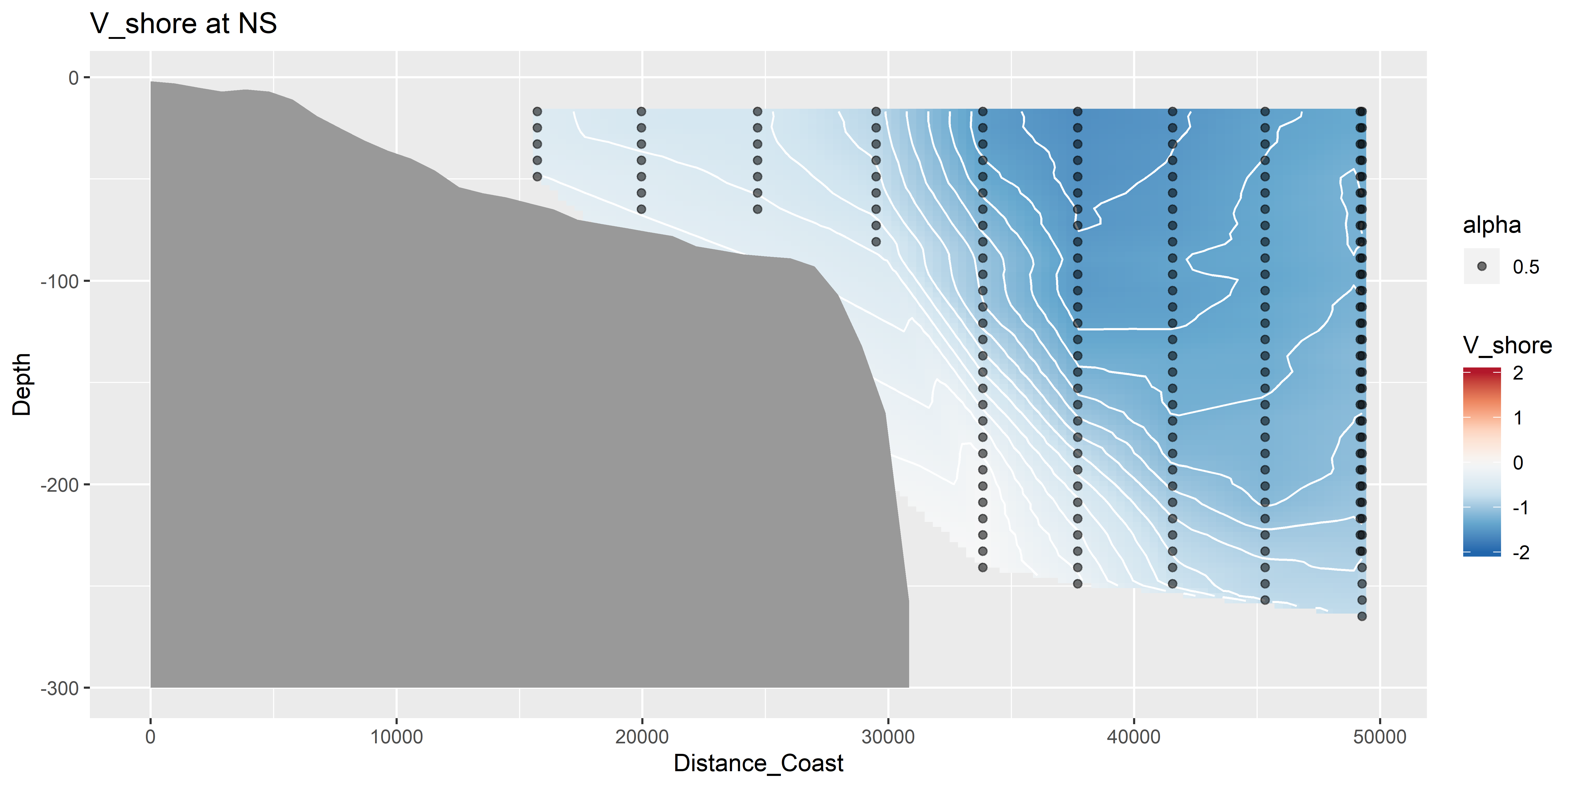
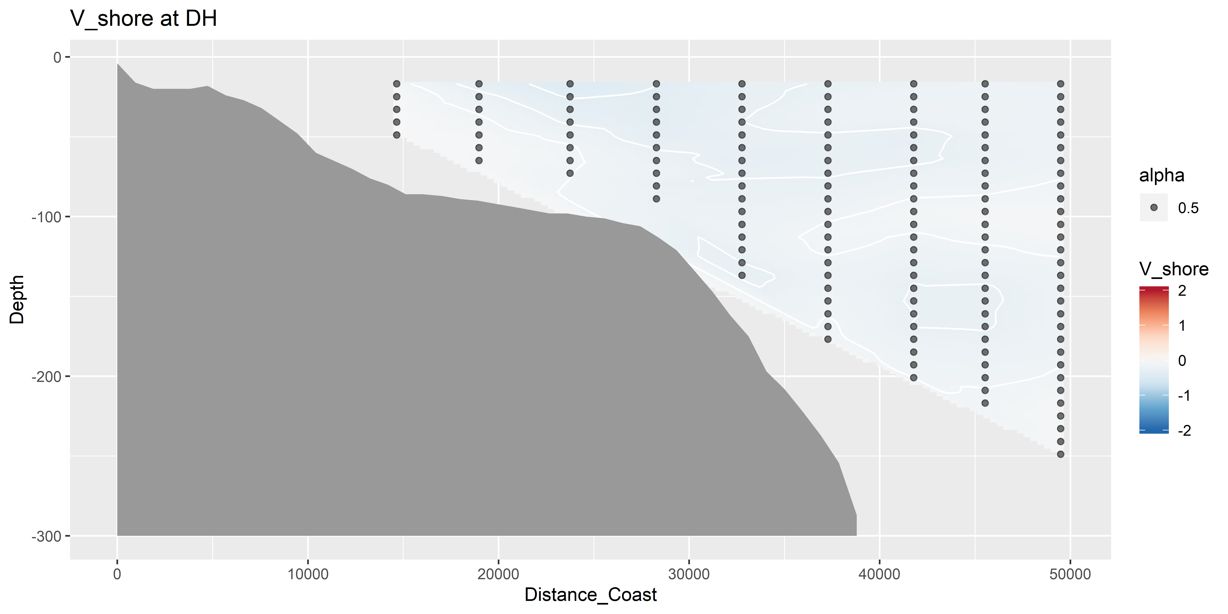
V vectors – shoreline rotated (m s⁻¹)

Slide 8
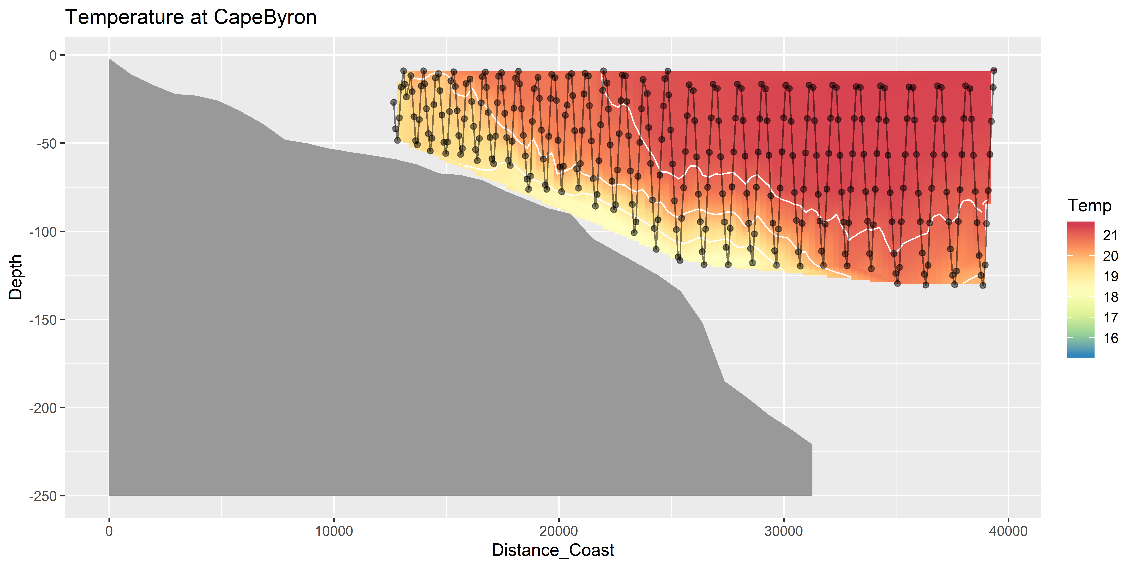
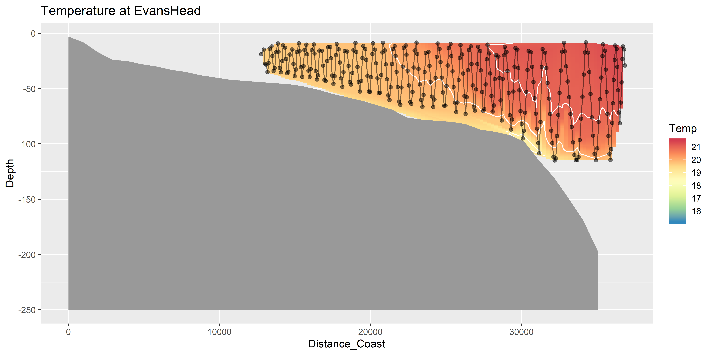
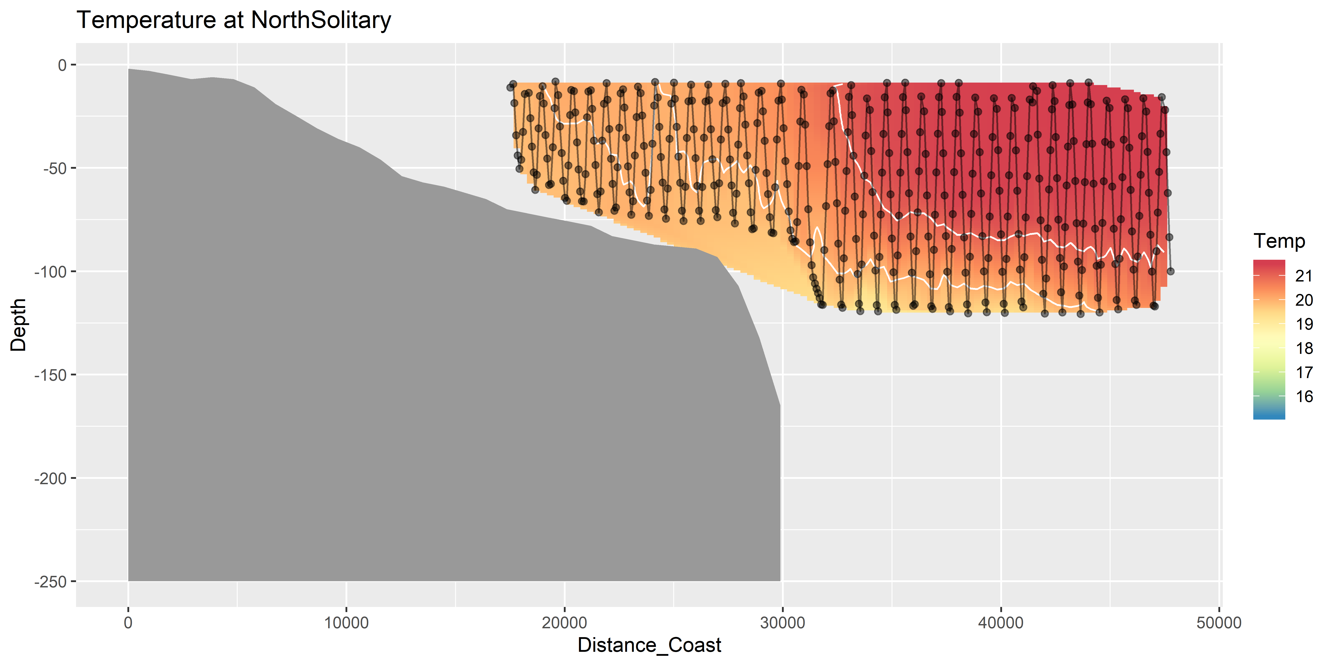
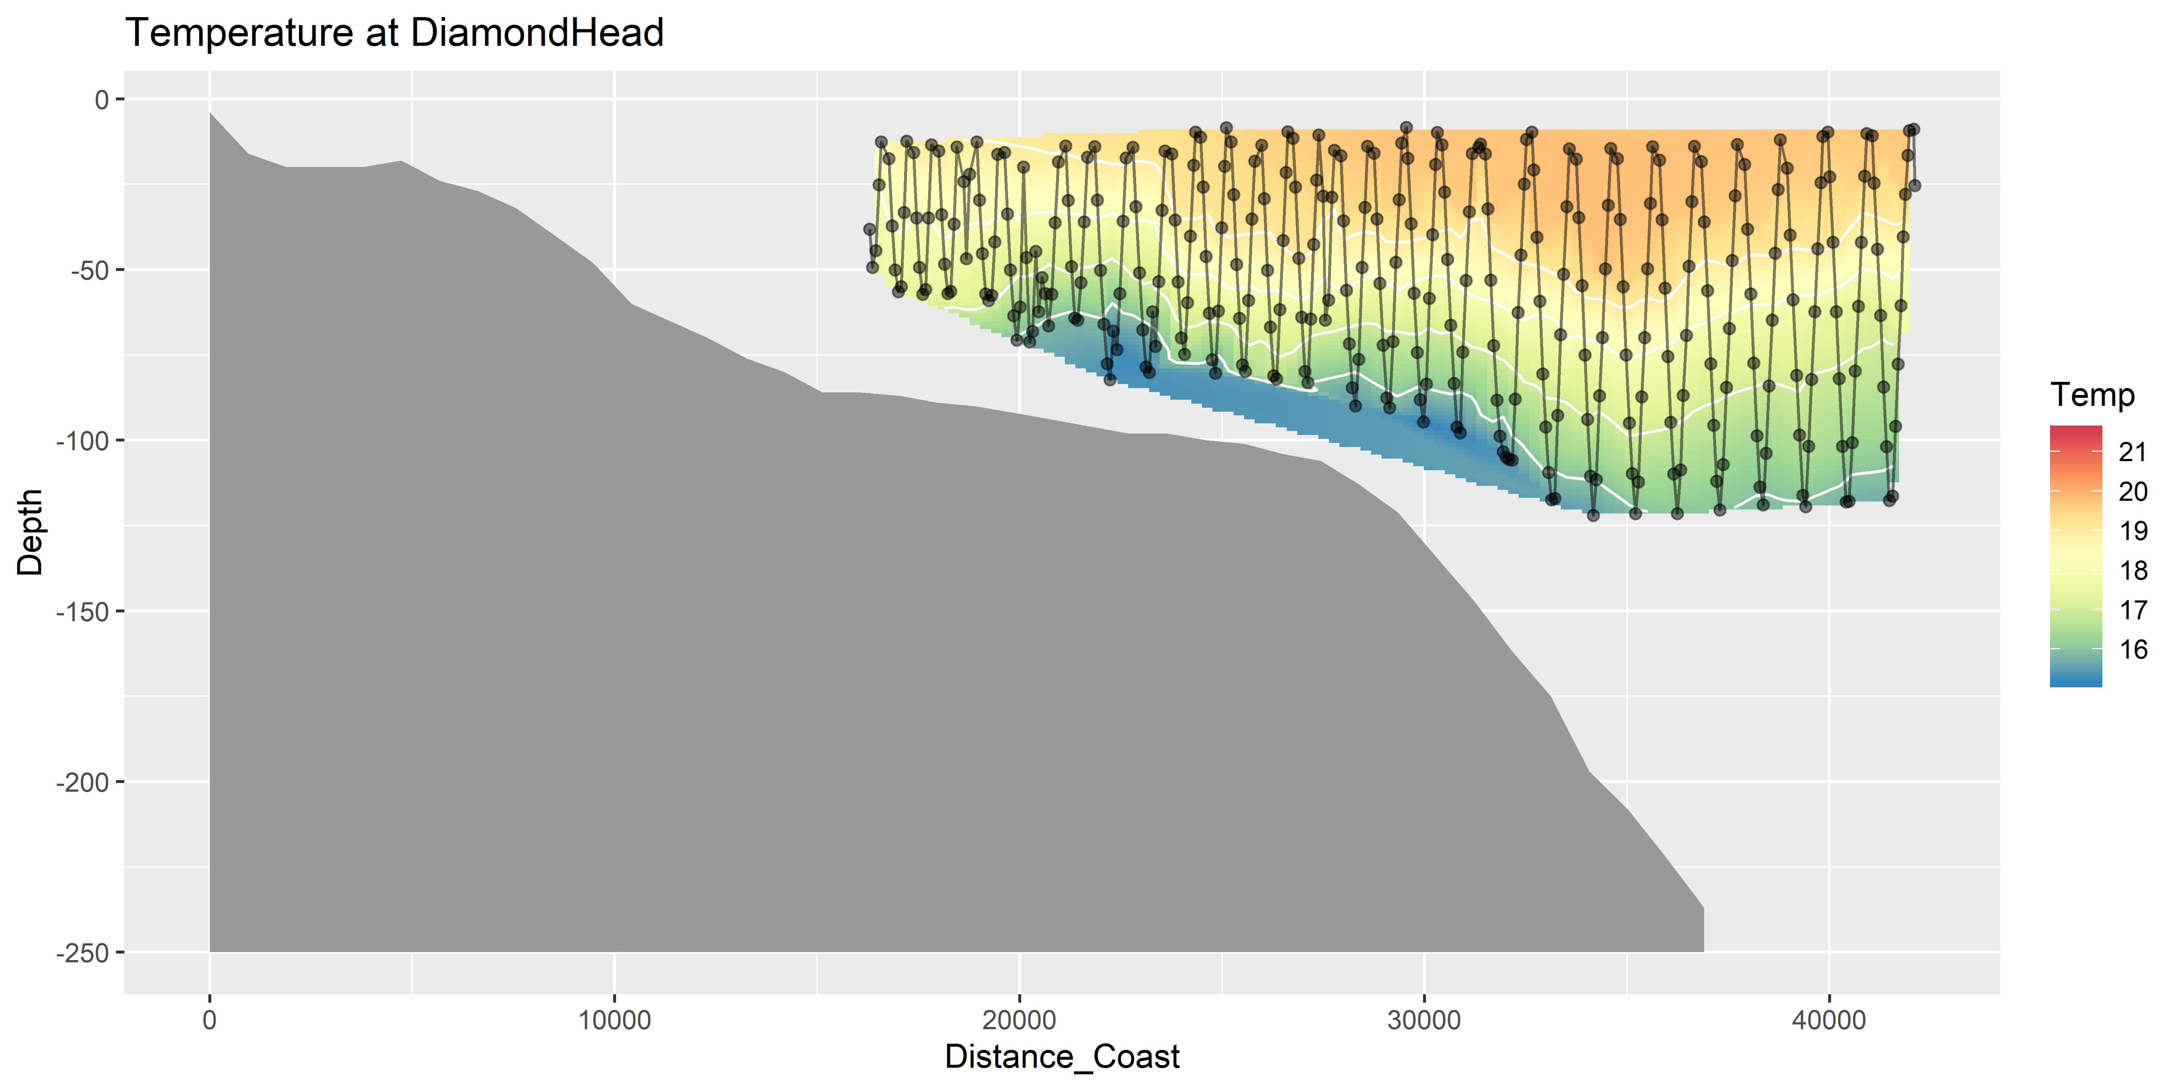
Temperature (seasoar)

Slide 9
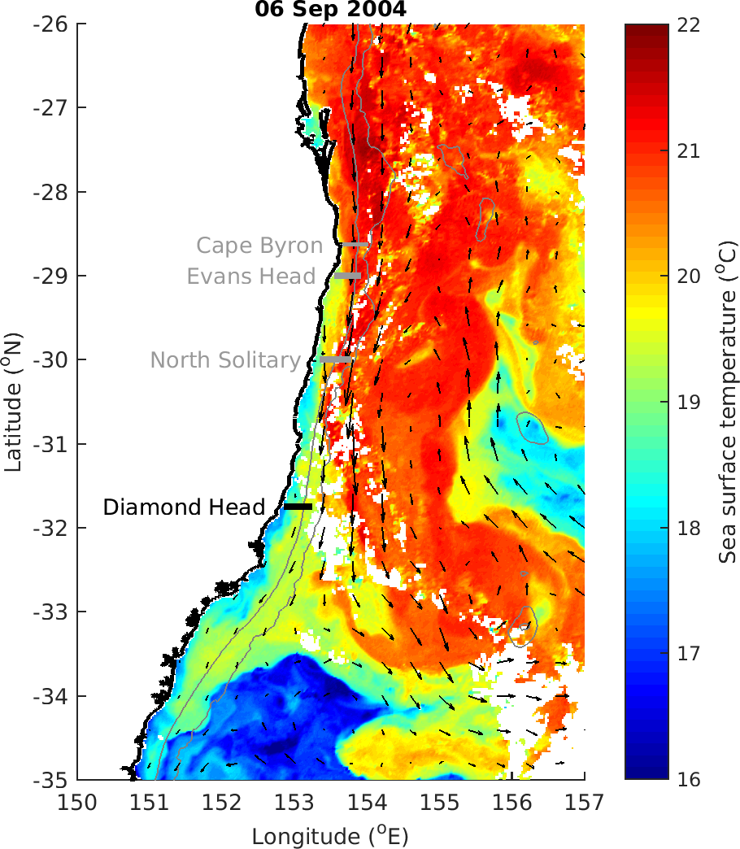

Slide 10
Zooplankton Characteristics
Biomass decreases with depth and distance from shore
Does size vary between the EAC water masses and separation zone?
Largest particles near shore at Diamond Head, due to separation and different water?
Slope does not appear to consistently approach -1 in offshore water (theoretical expectation)
Vandromme showed shallower slope offshore (-1 → -0.4; SW France)

Slide 11
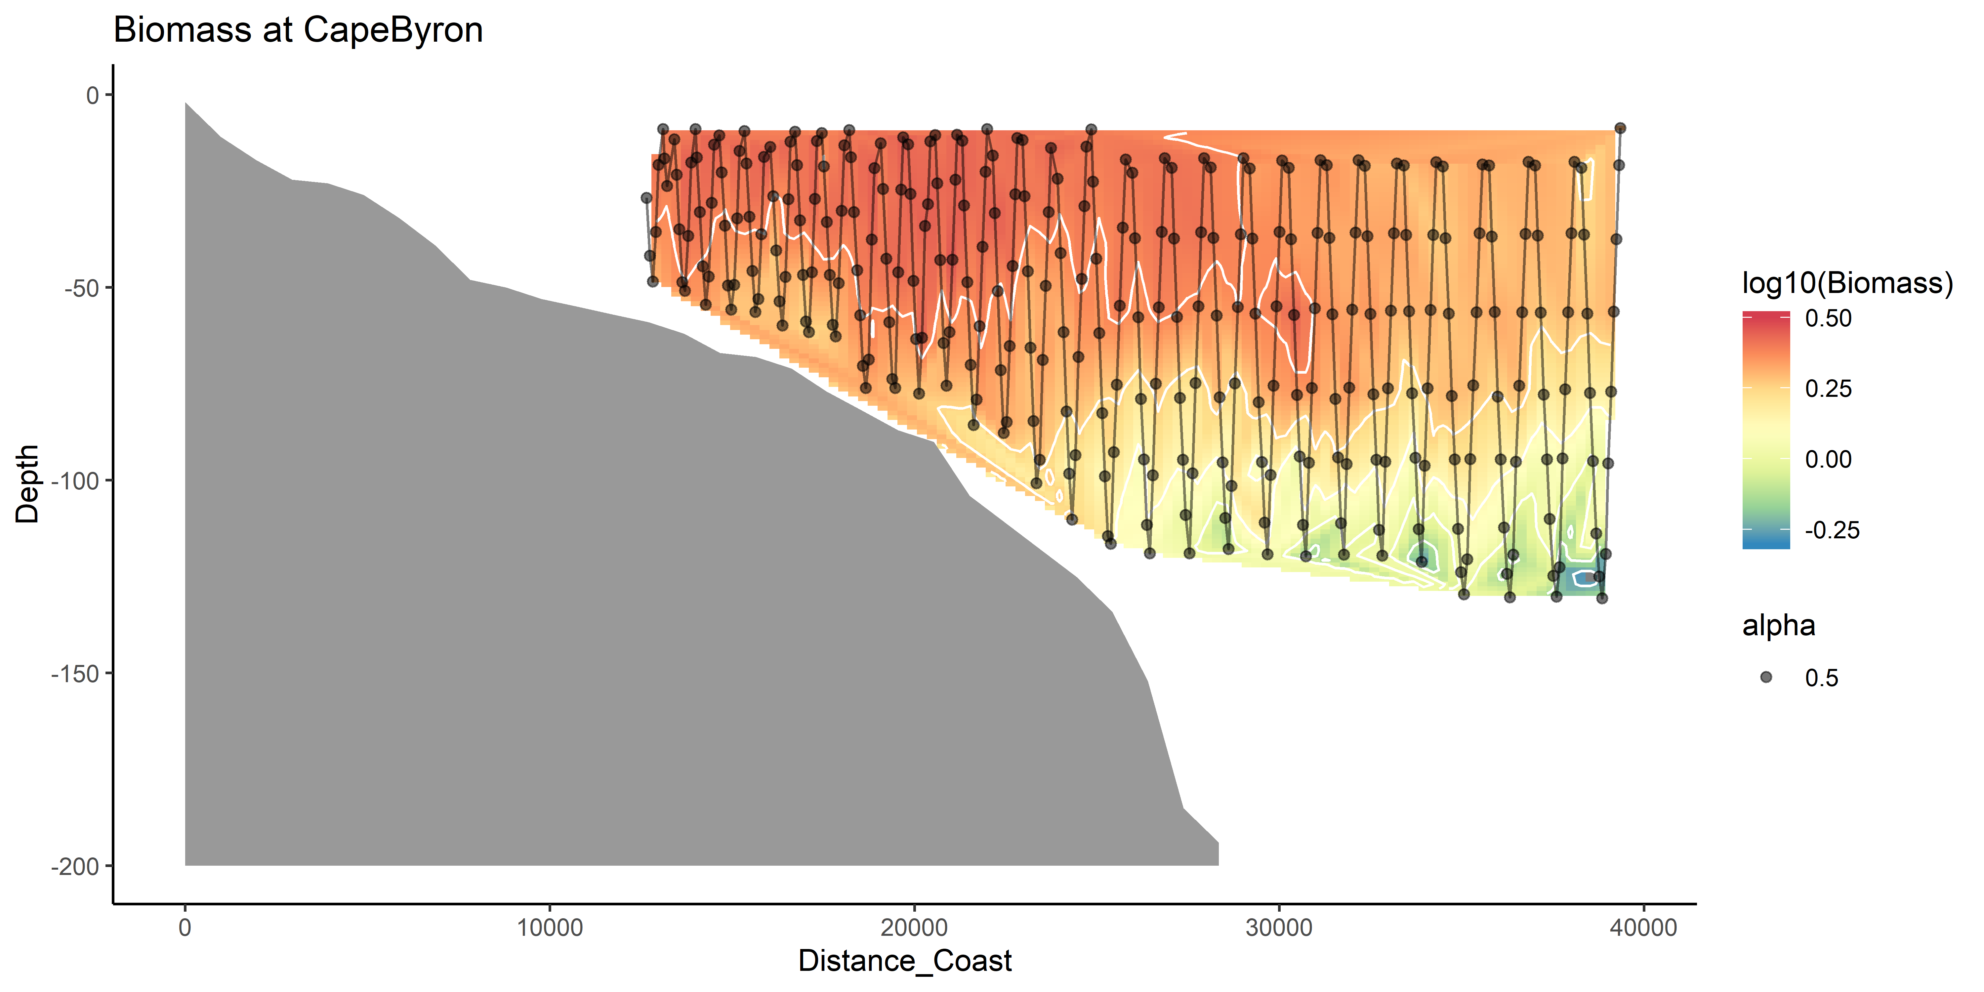
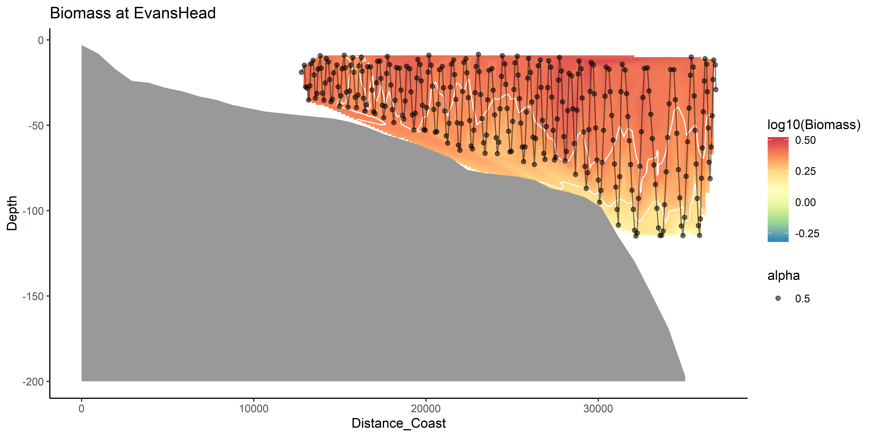
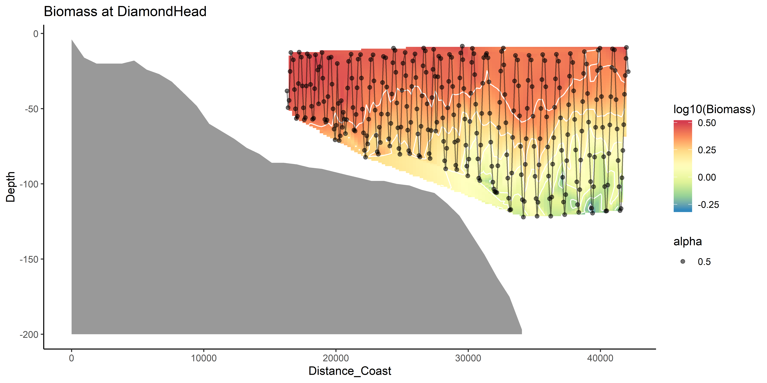
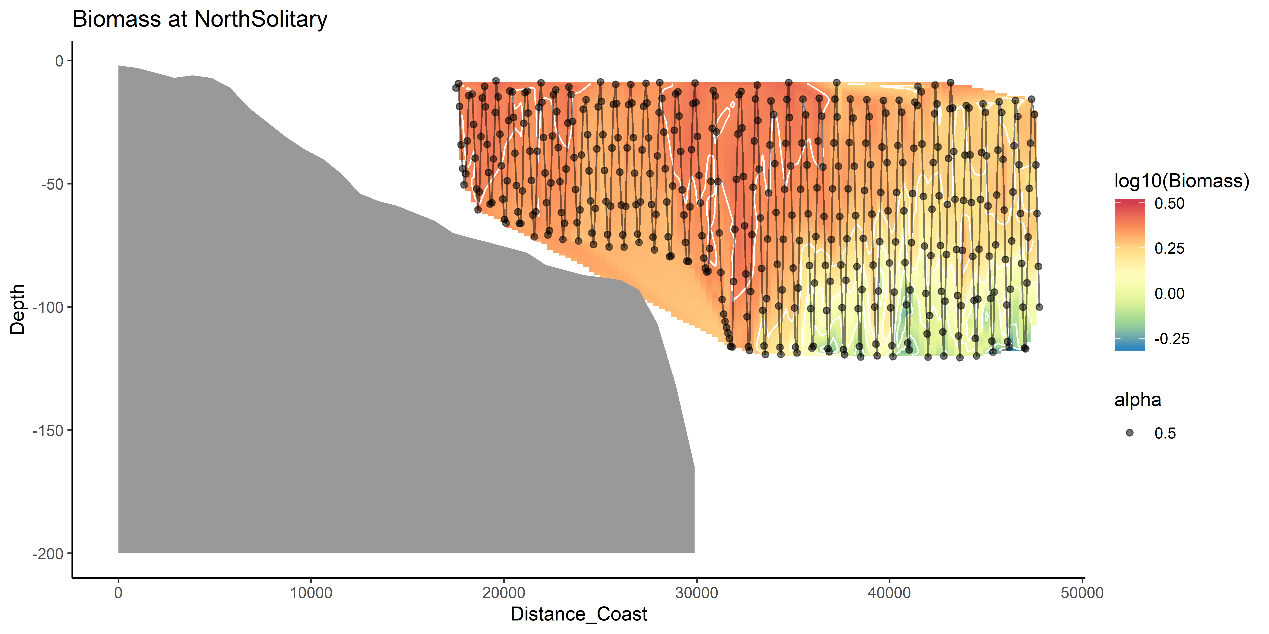
Zooplankton Biomass

Slide 12
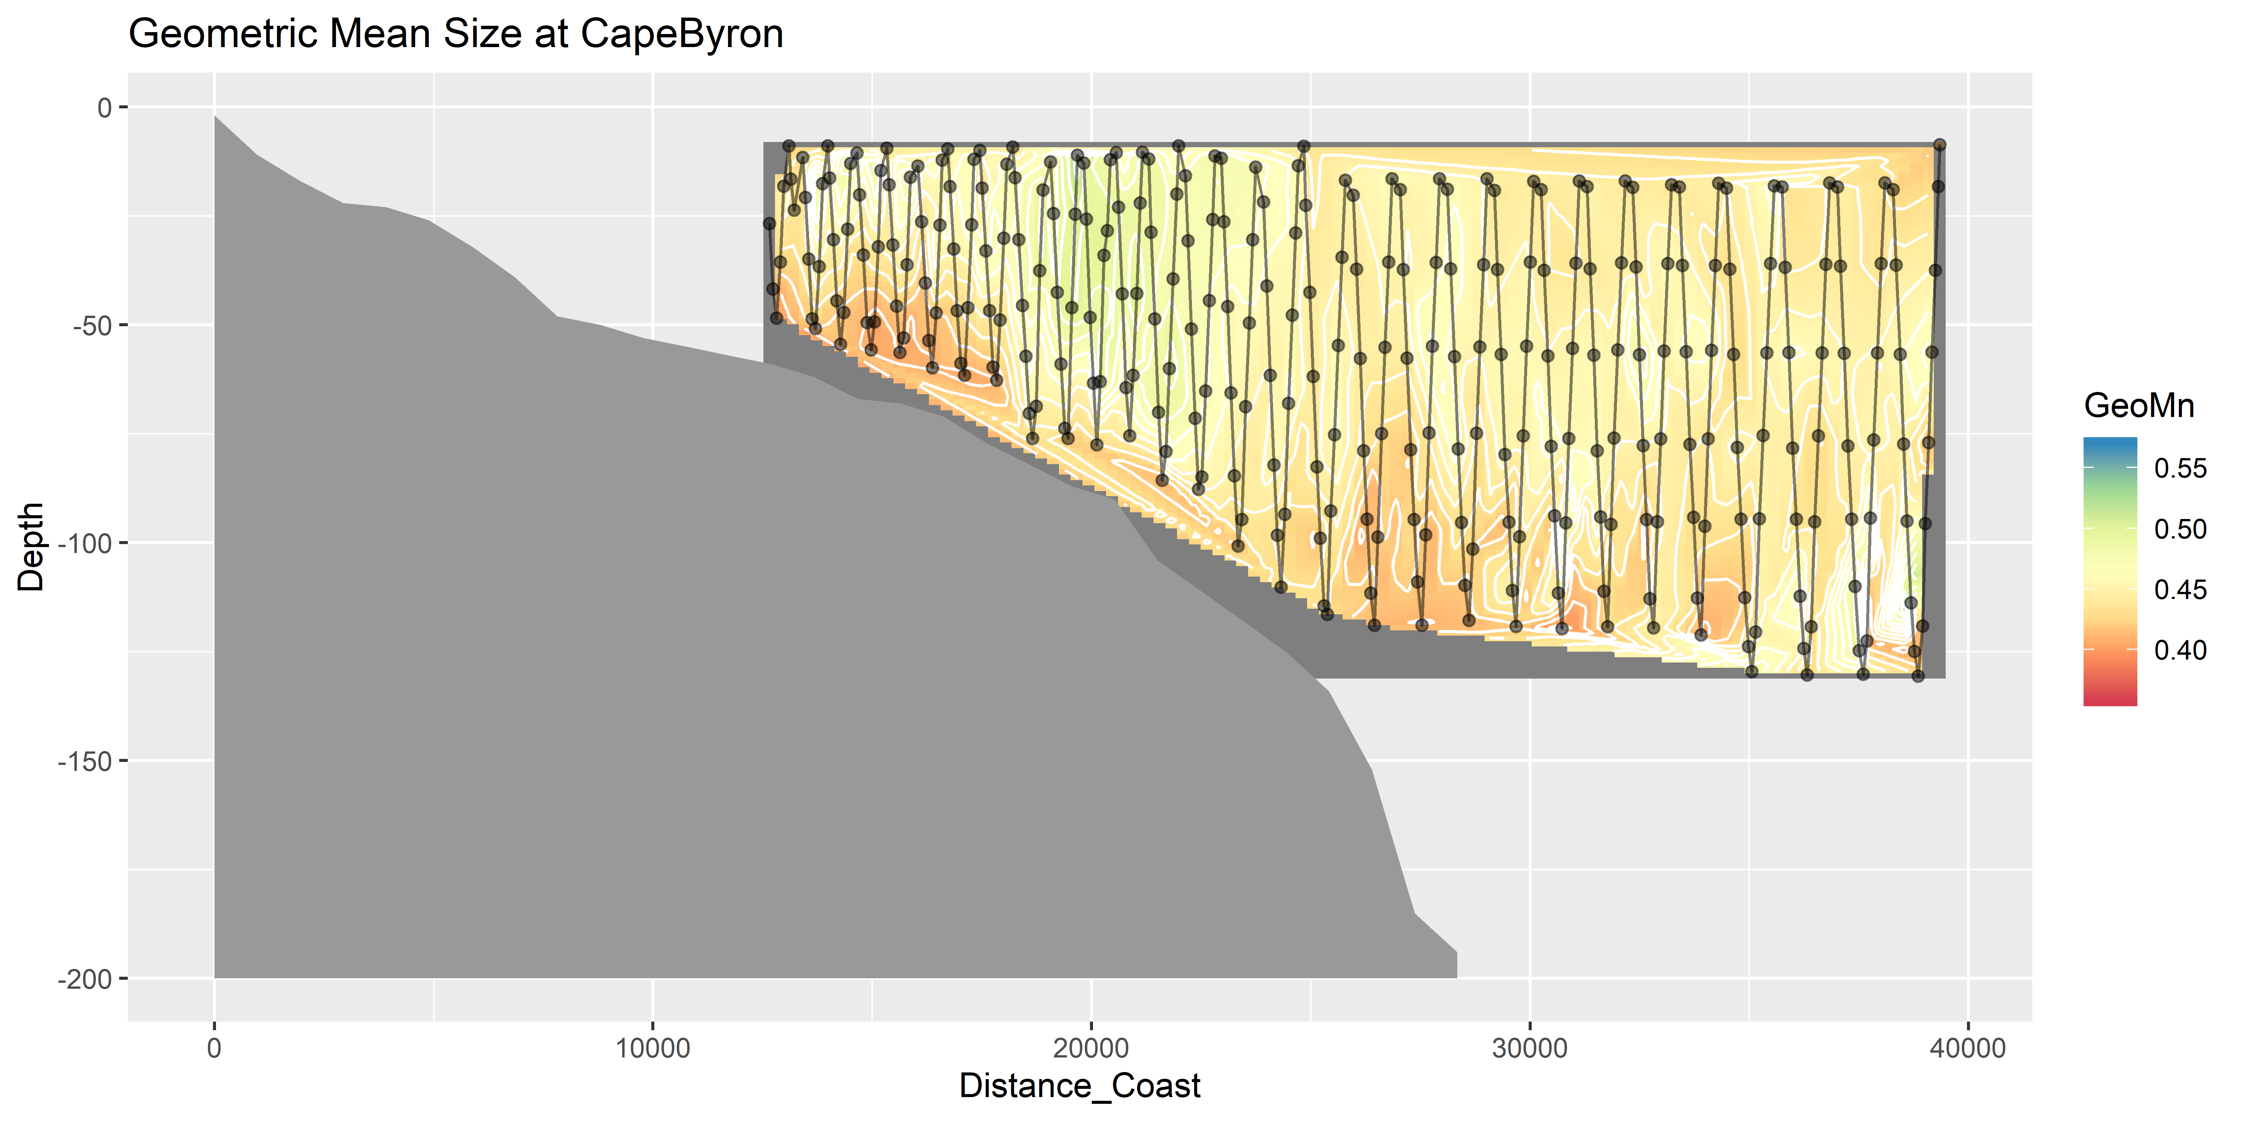
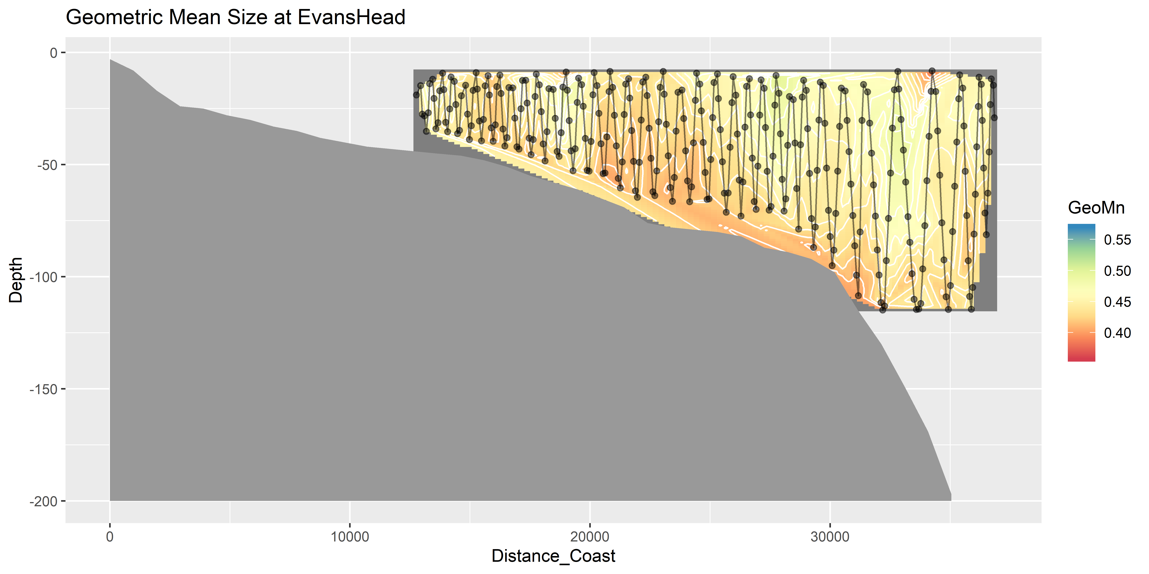
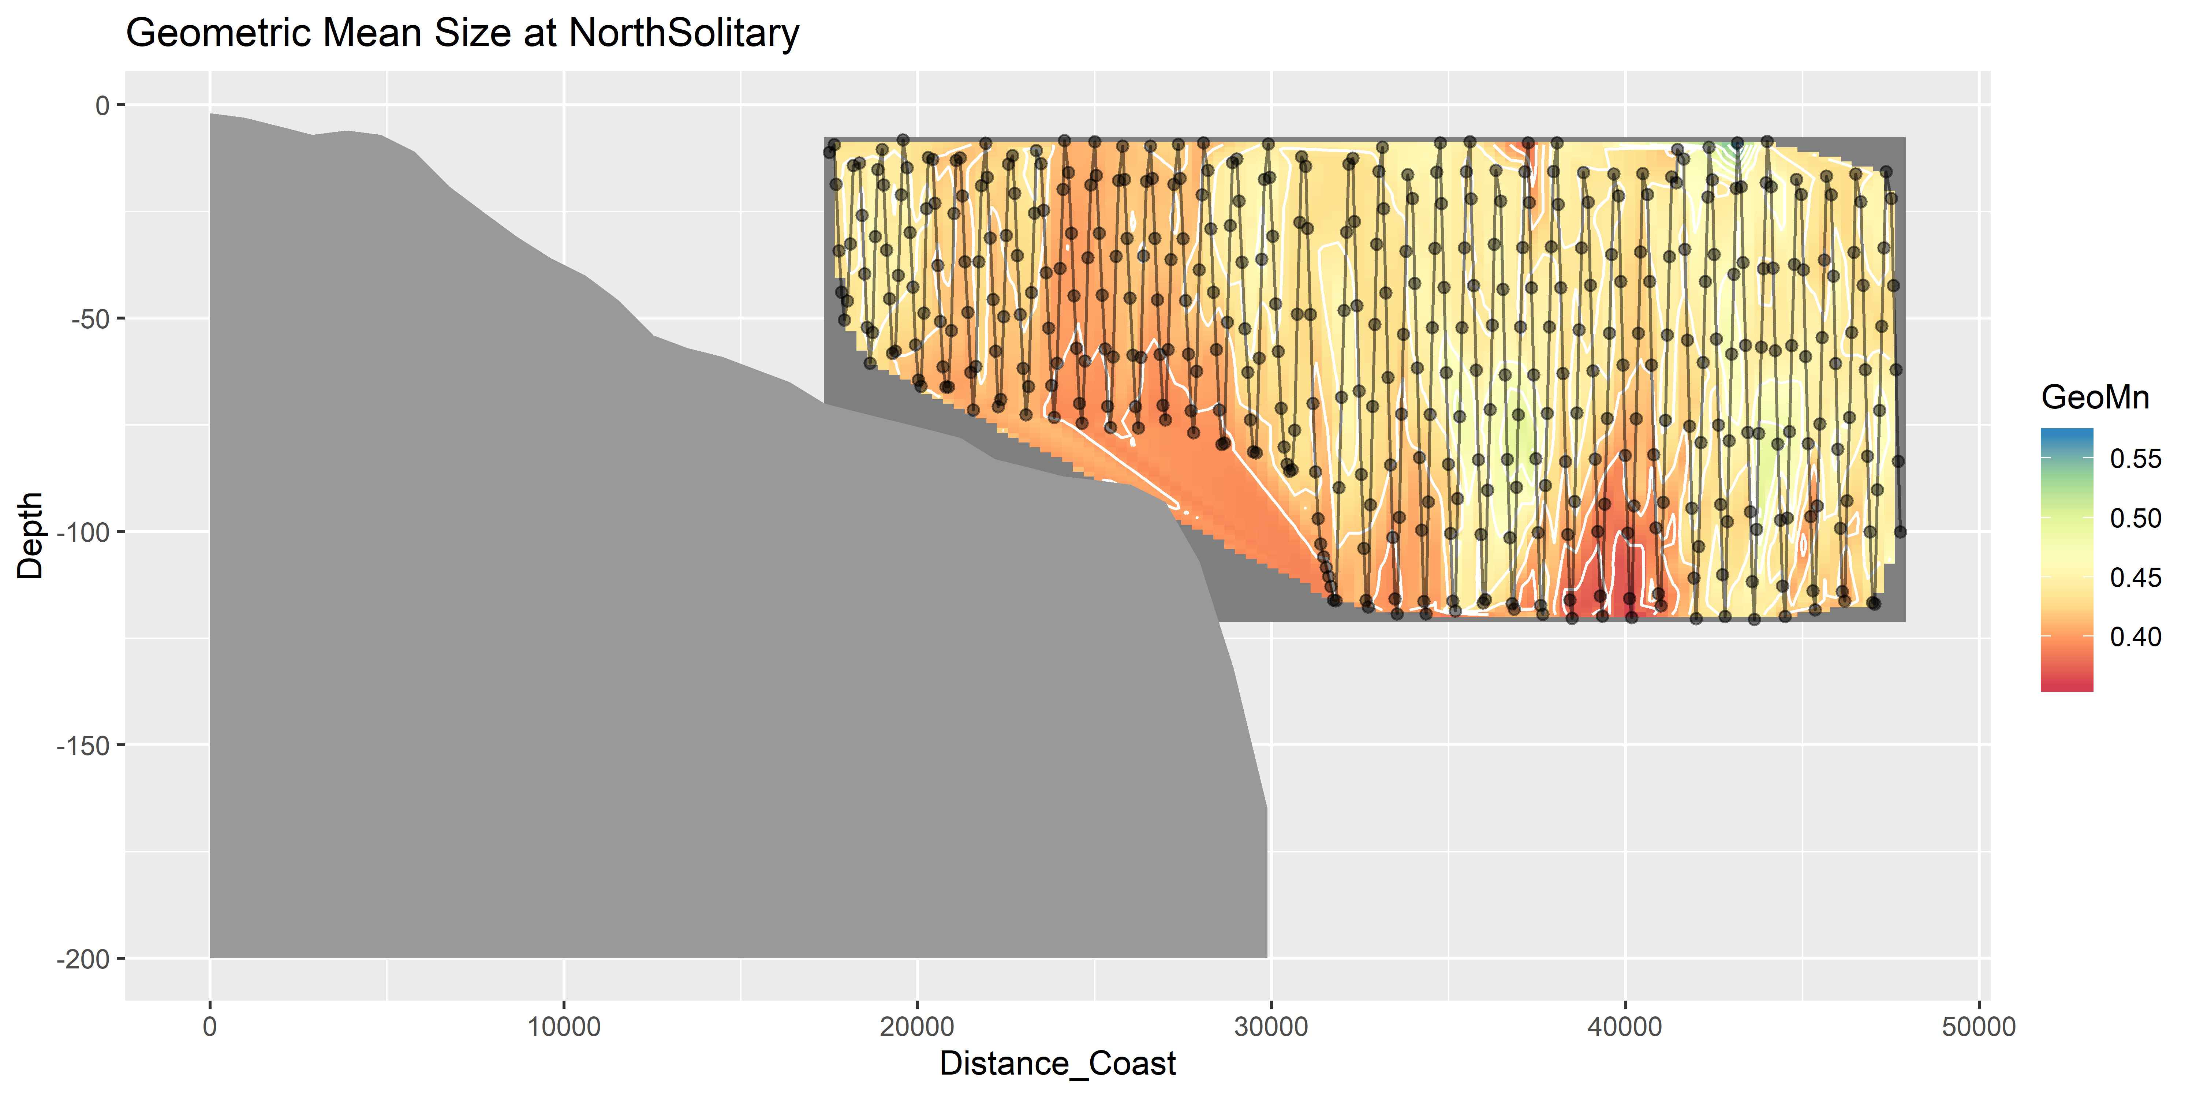
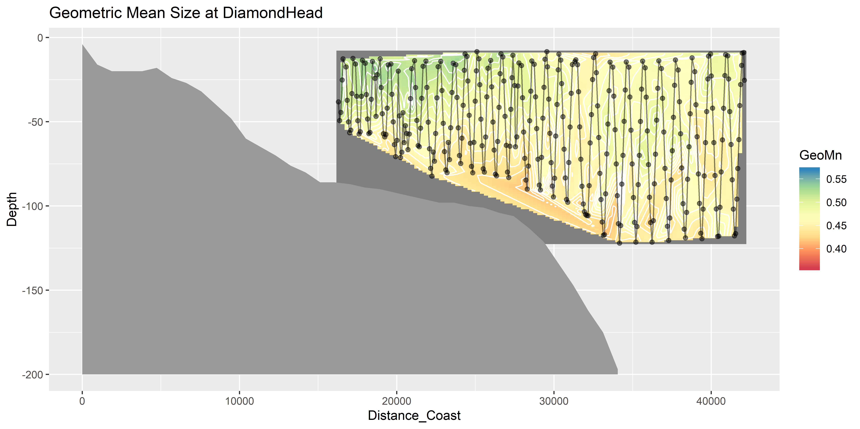
Geometric Mean Size

Slide 13
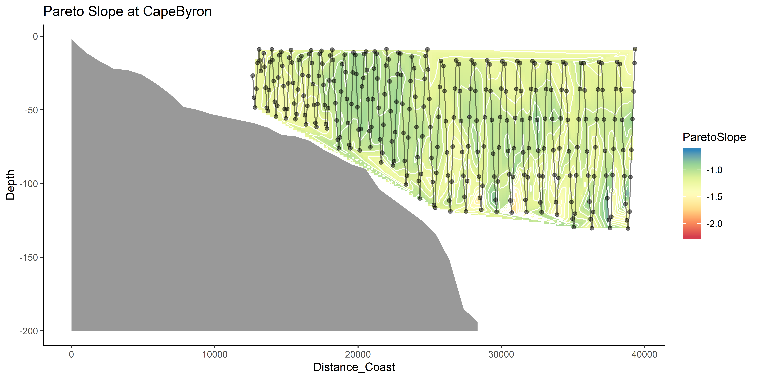
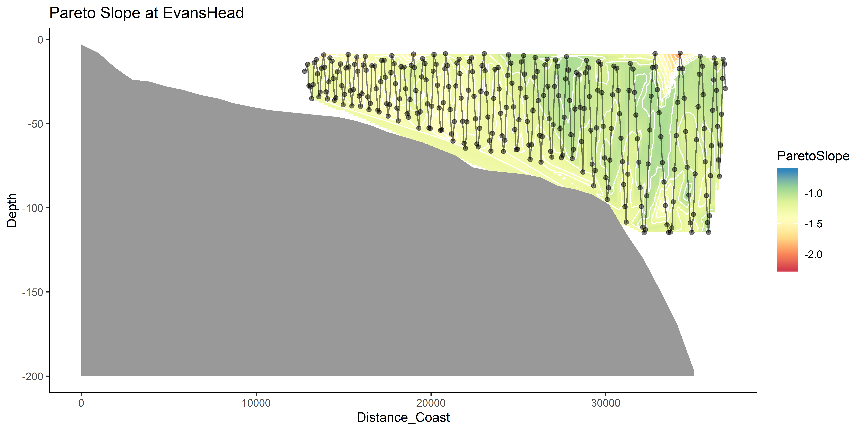
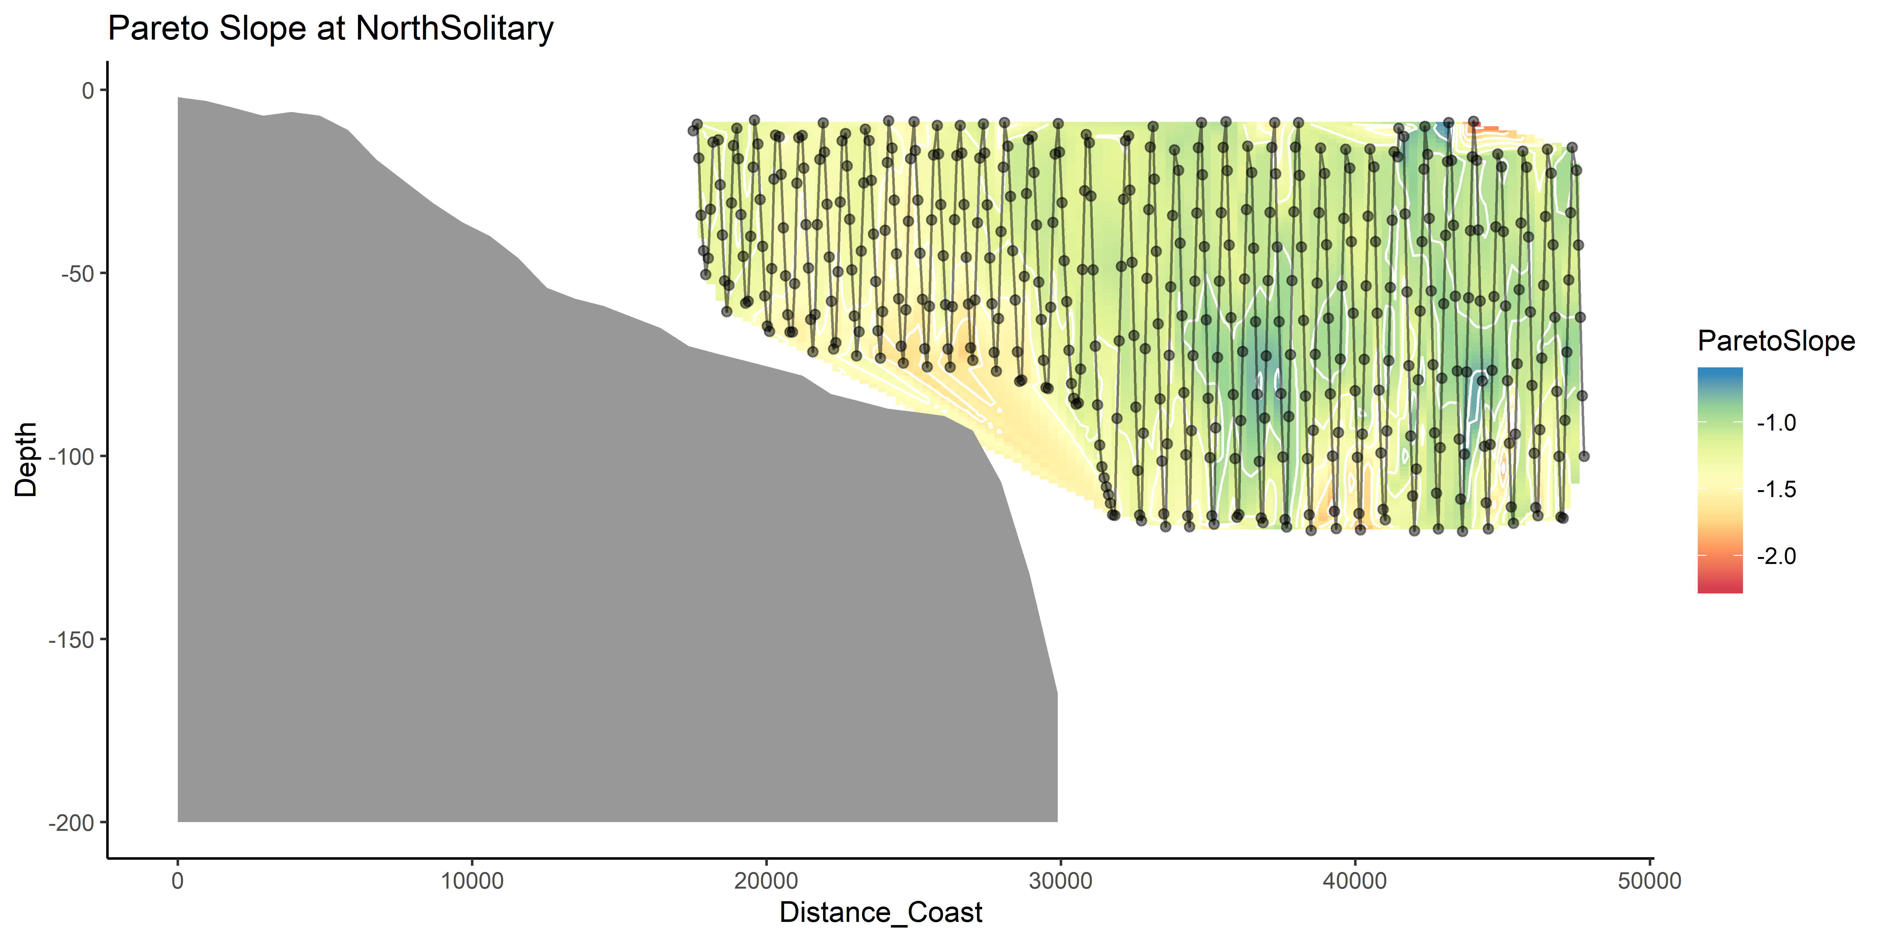
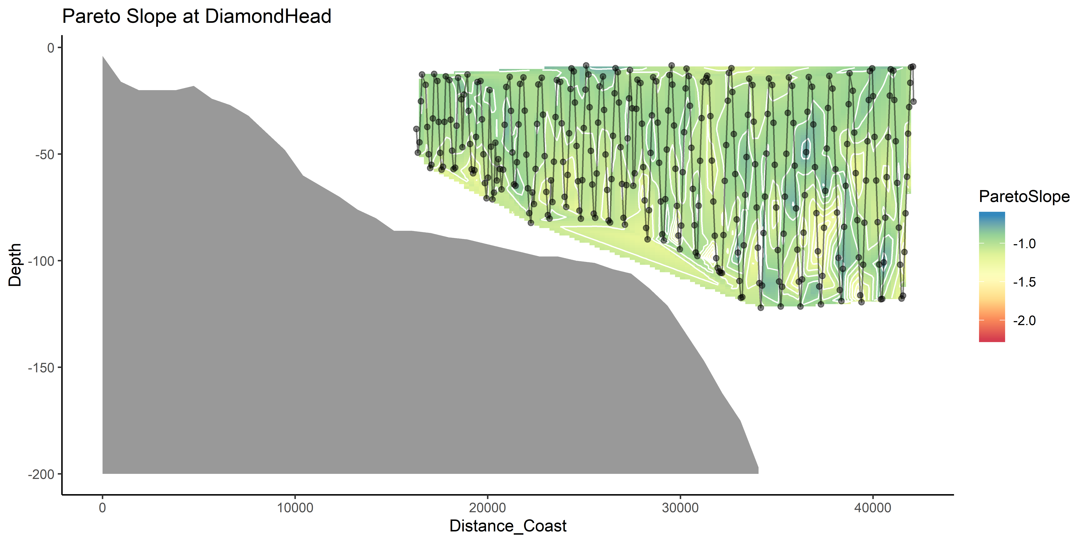
Pareto Slope

Slide 14
Linking water and zooplankton
Temp + Salt highly correlated (0.93)
Temp + Depth slight neg. cor. (-0.3)
Temp + Distance_Coast slight pos. cor (0.24)
Longitude + Distance_Coast slight pos. cor (0.09)
Moran’s I value = 0.33 (Biomass)
Moran’s I value = 0.29 (Pareto Slope)

Slide 15
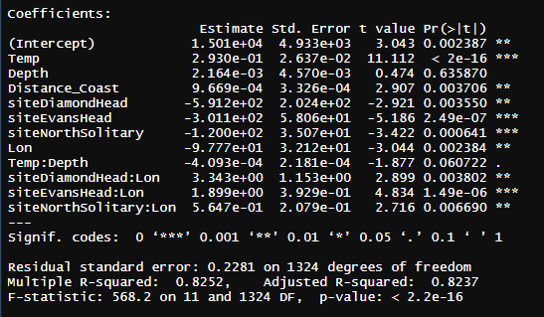
Zooplankton Biomass models
log10(Biomass) ~ Temp * Depth + Distance_Coast + site * Lon, data = mydataX)

Slide 16
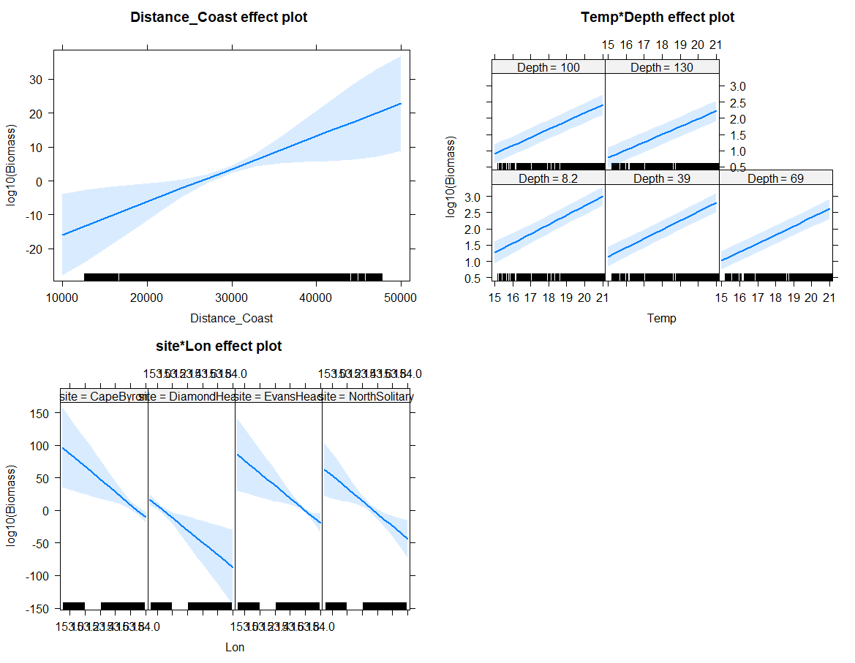

Slide 17
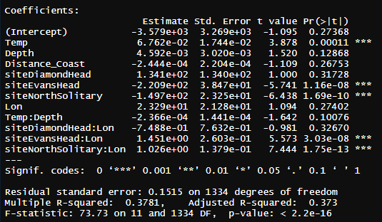
Pareto Slope Model
ParetoSlope ~ Temp * Depth + Distance_Coast + site * Lon

Slide 18
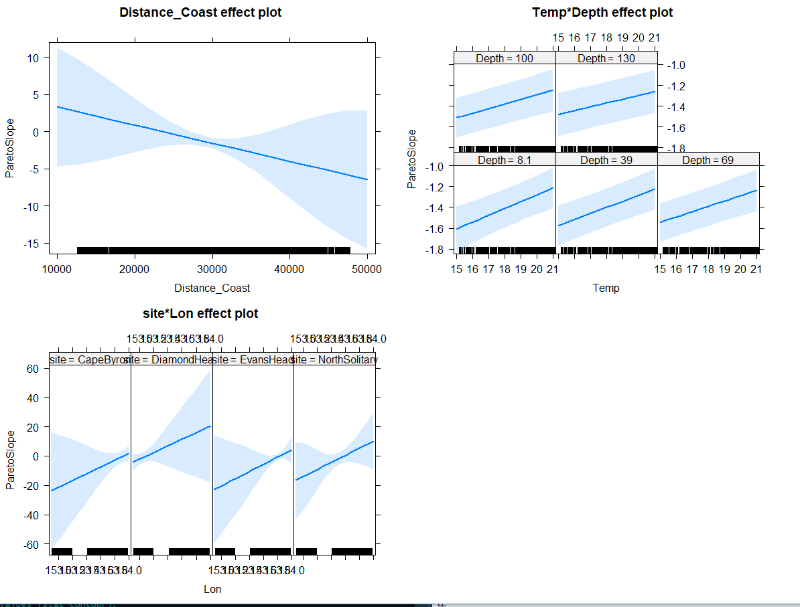

Slide 19
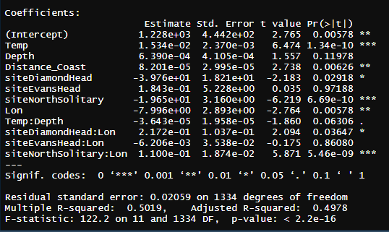
GeoMn Size
GeoMn*1000 ~ Temp * Depth + Distance_Coast + site * Lon, data = mydata

Slide 20
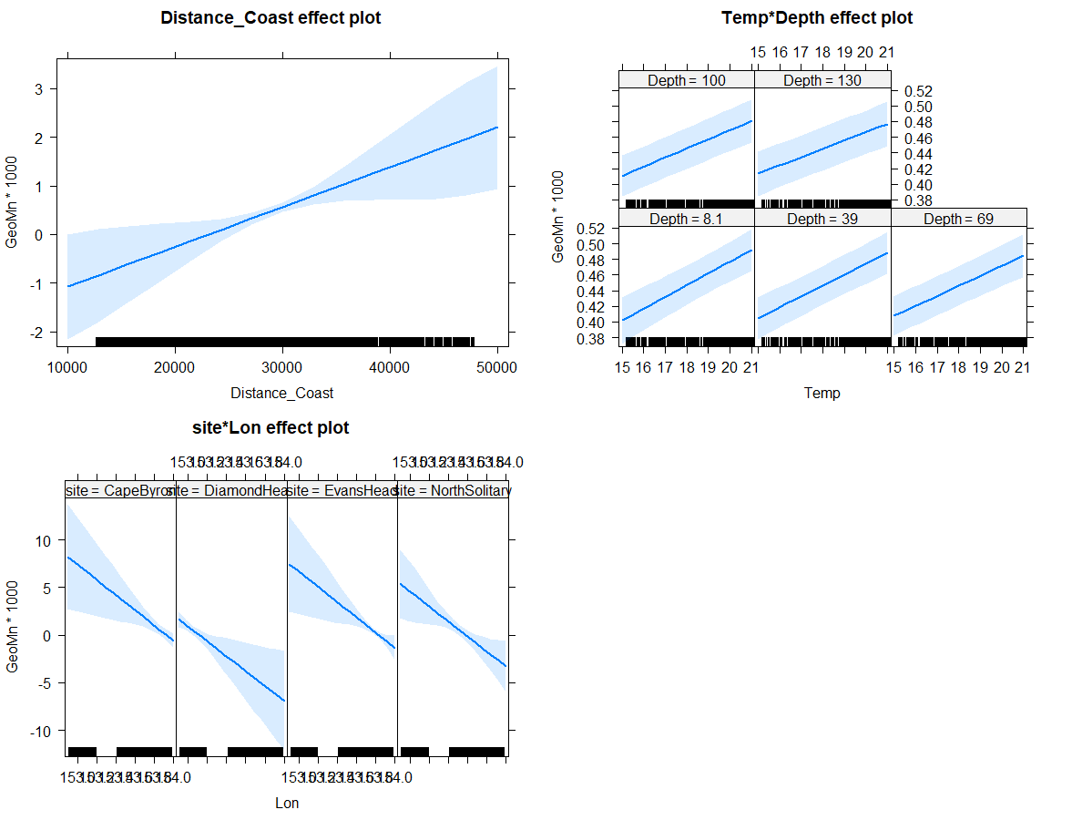

Slide 21
Larger context (not for today)
How typical are the observations seen in these transects?
Temp and Sal
Chl-a
IMOS NRS Moorings
Gliders
Satellite data

Slide 23
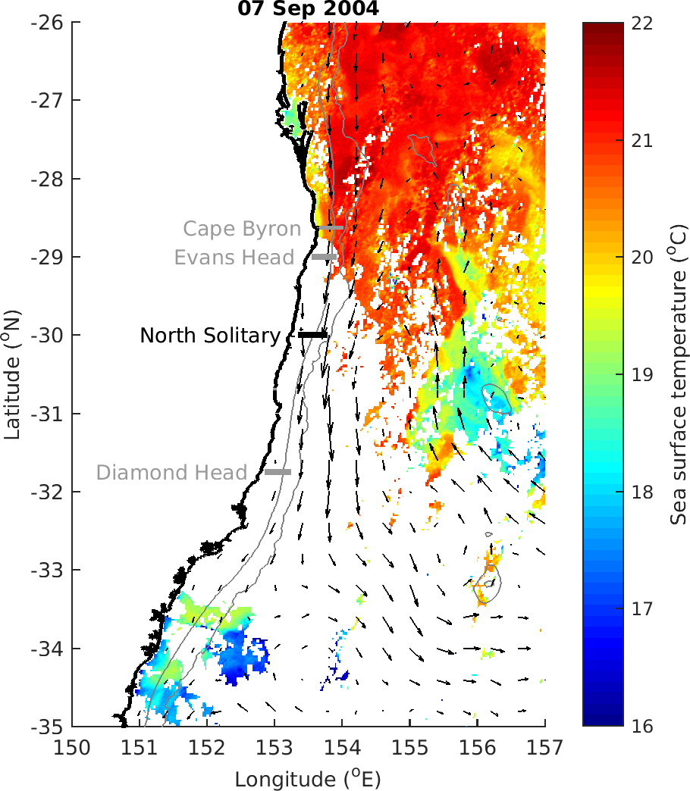

Slide 24
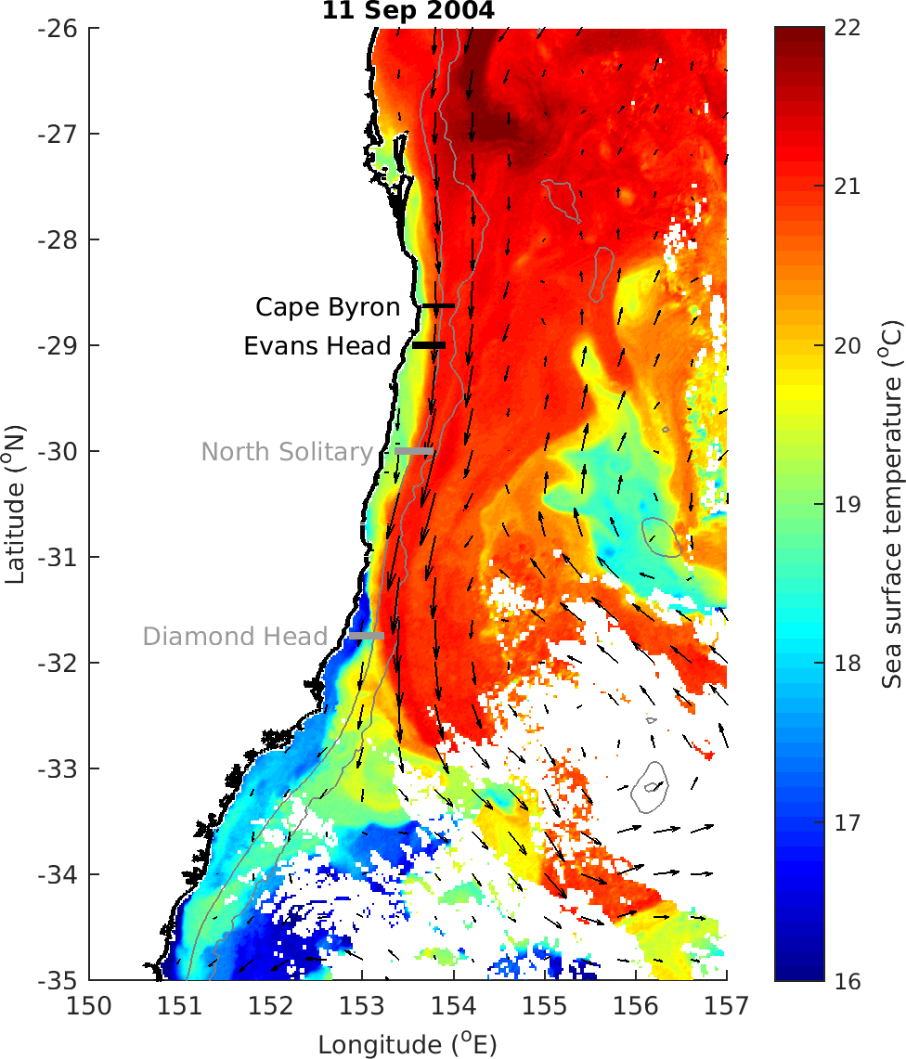

Slide 25
MODIS Chl_a

Slide 26
T-S Plot all depths (CTD)

Slide 27
TS Plot by log₁₀(Biomass)

Slide 28
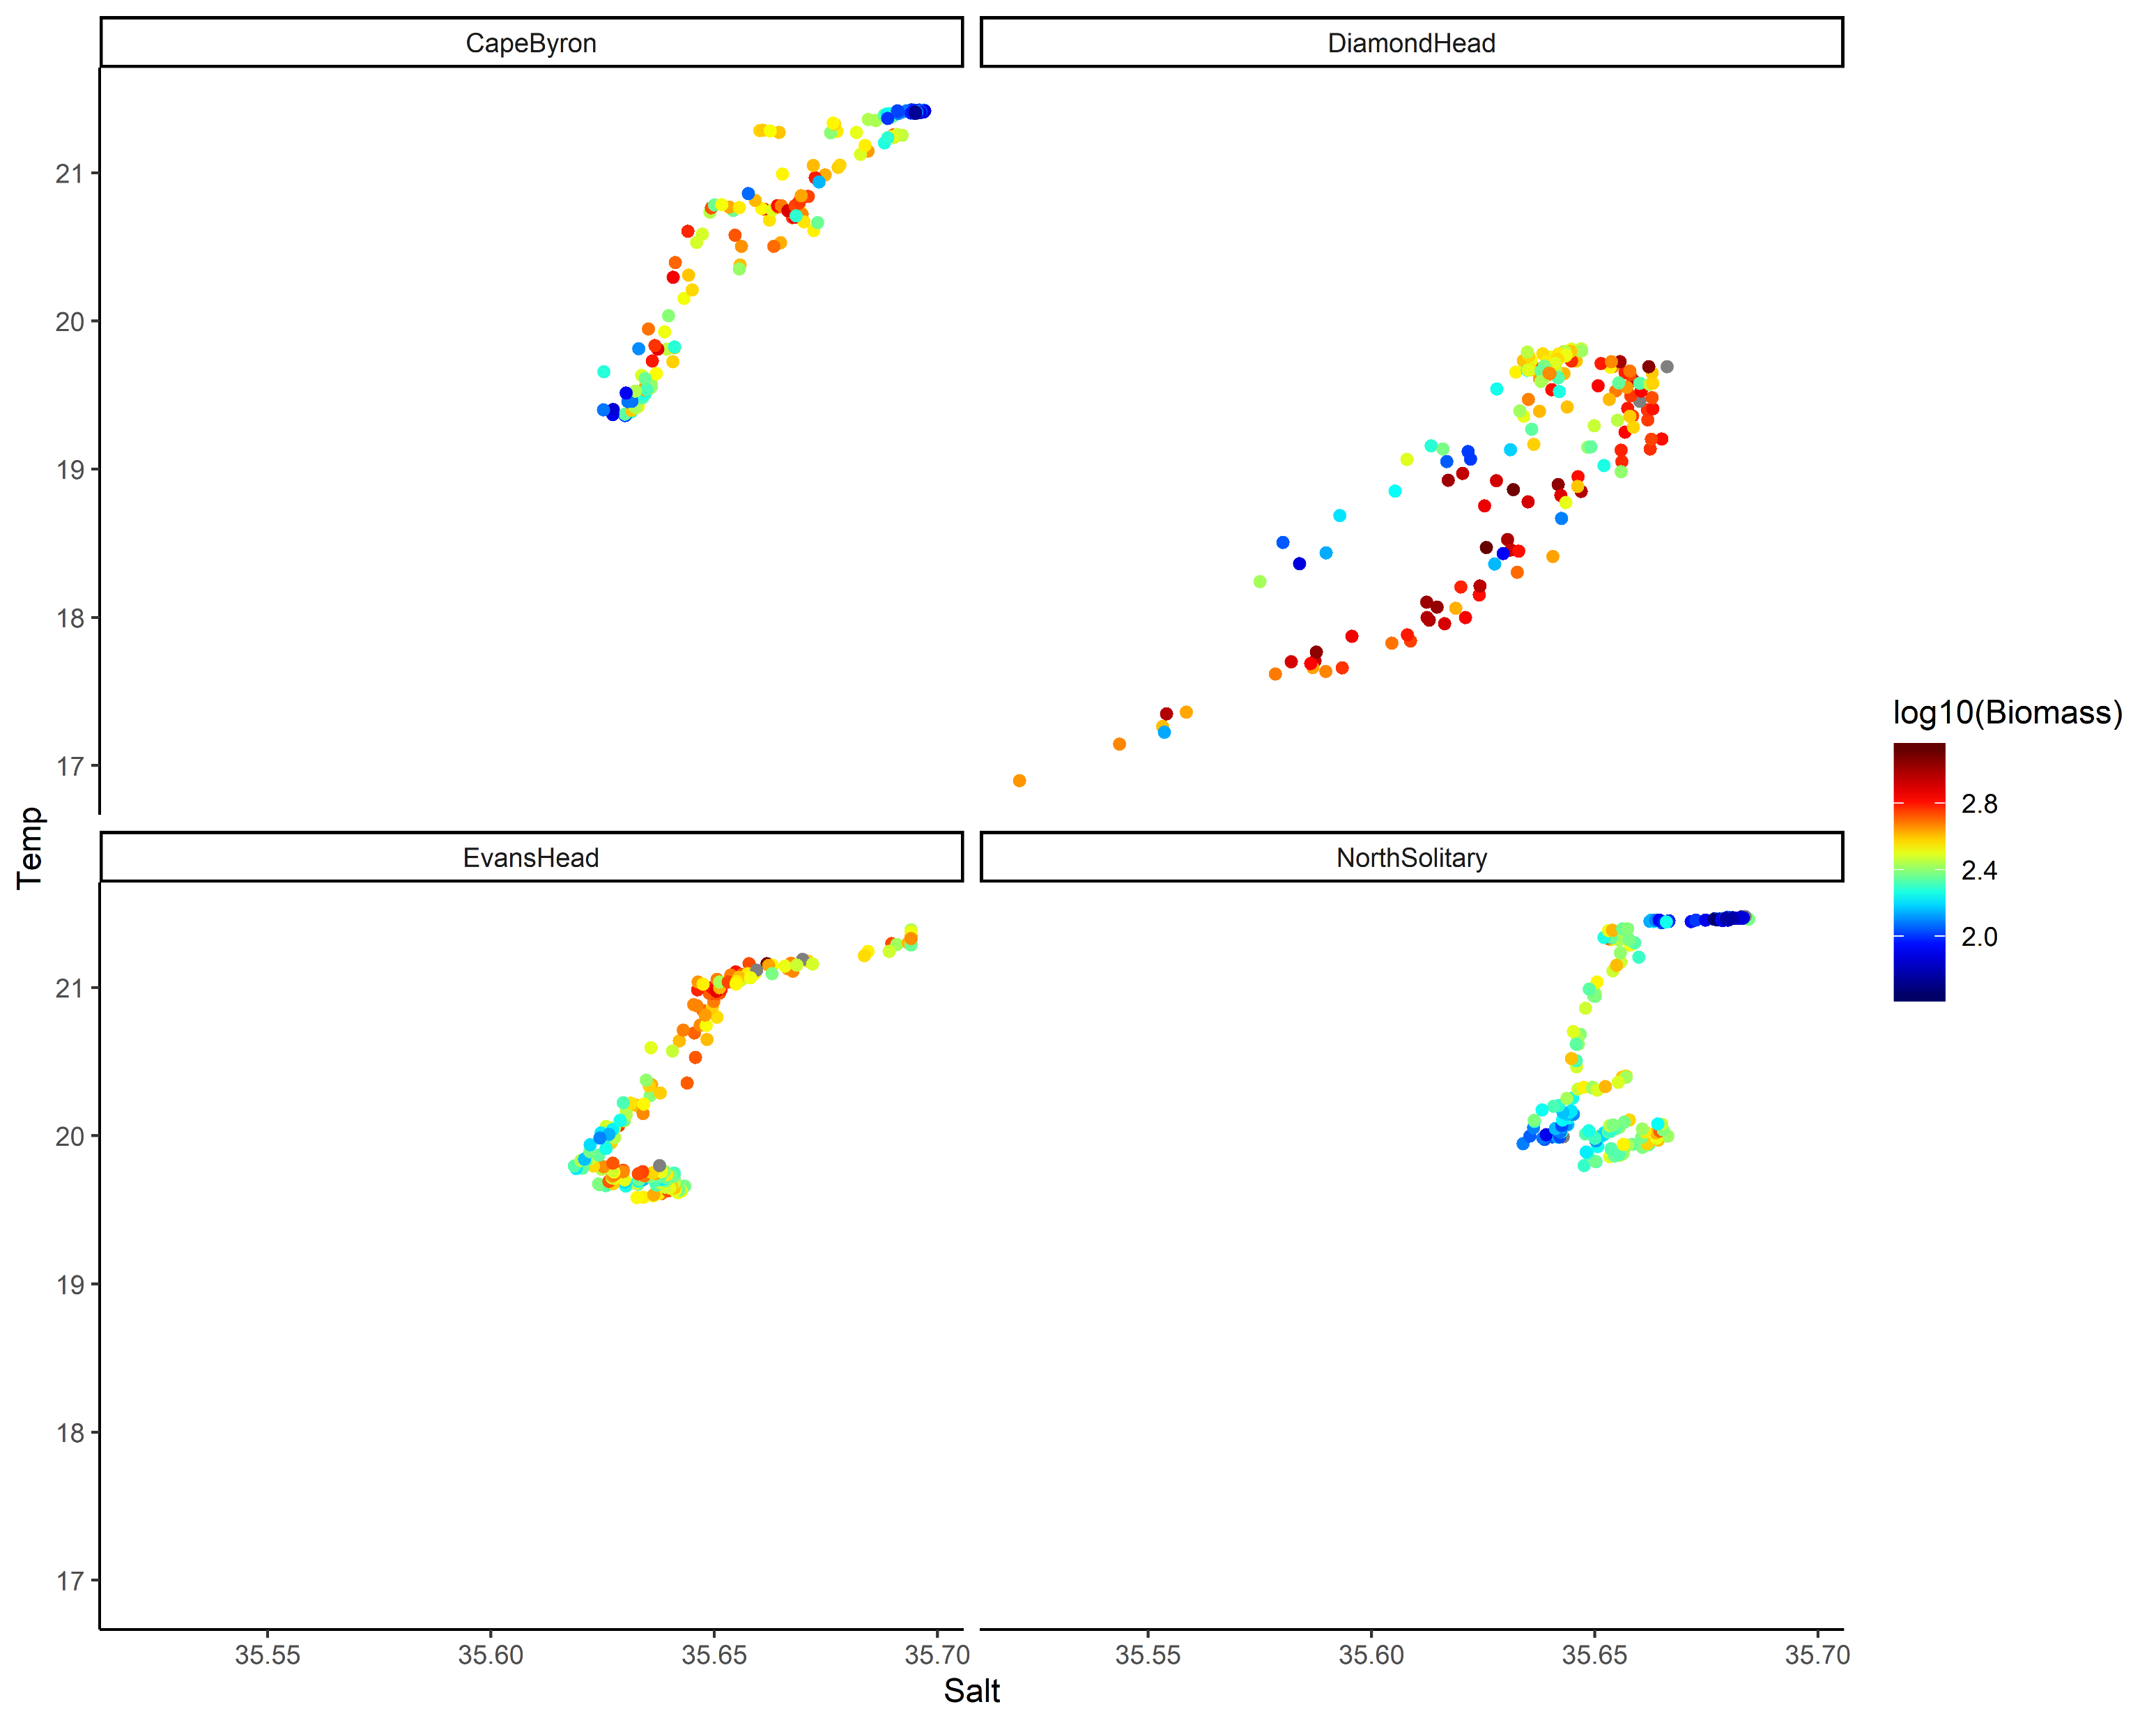
TS Plot by log₁₀(Biomass) top 50m

Slide 29
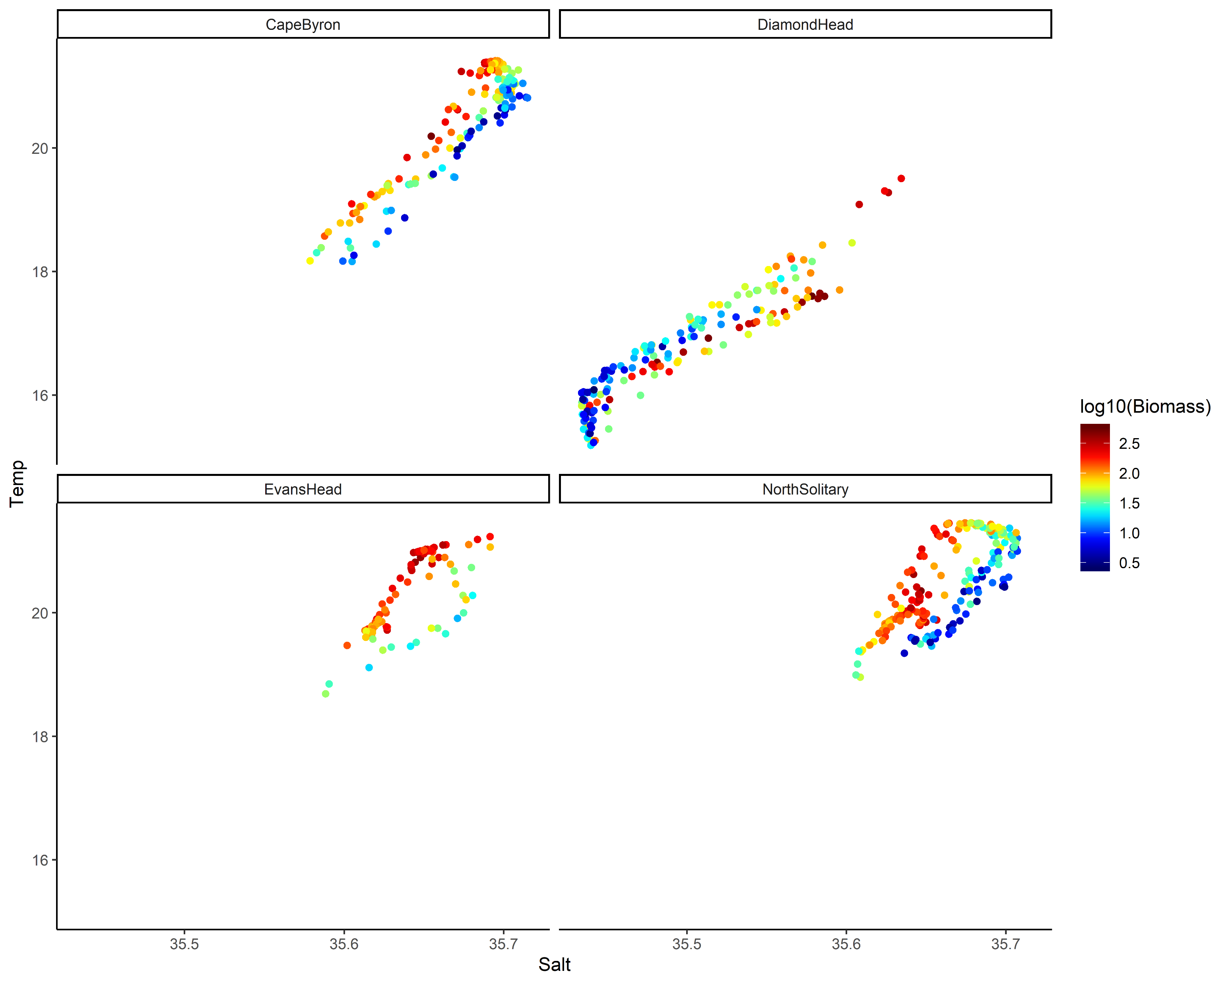
TS Plot by log₁₀(Biomass) below 50m

Slide 30
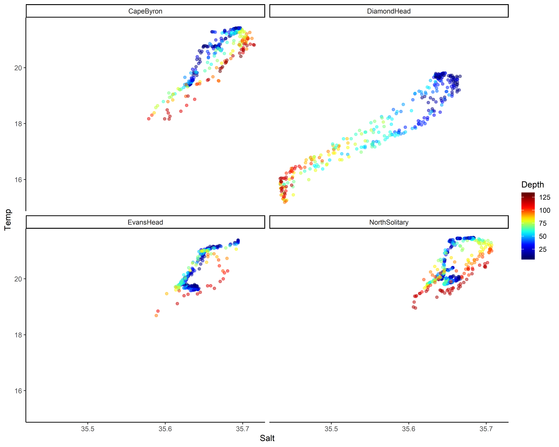
TS plot by Depth

Slide 31
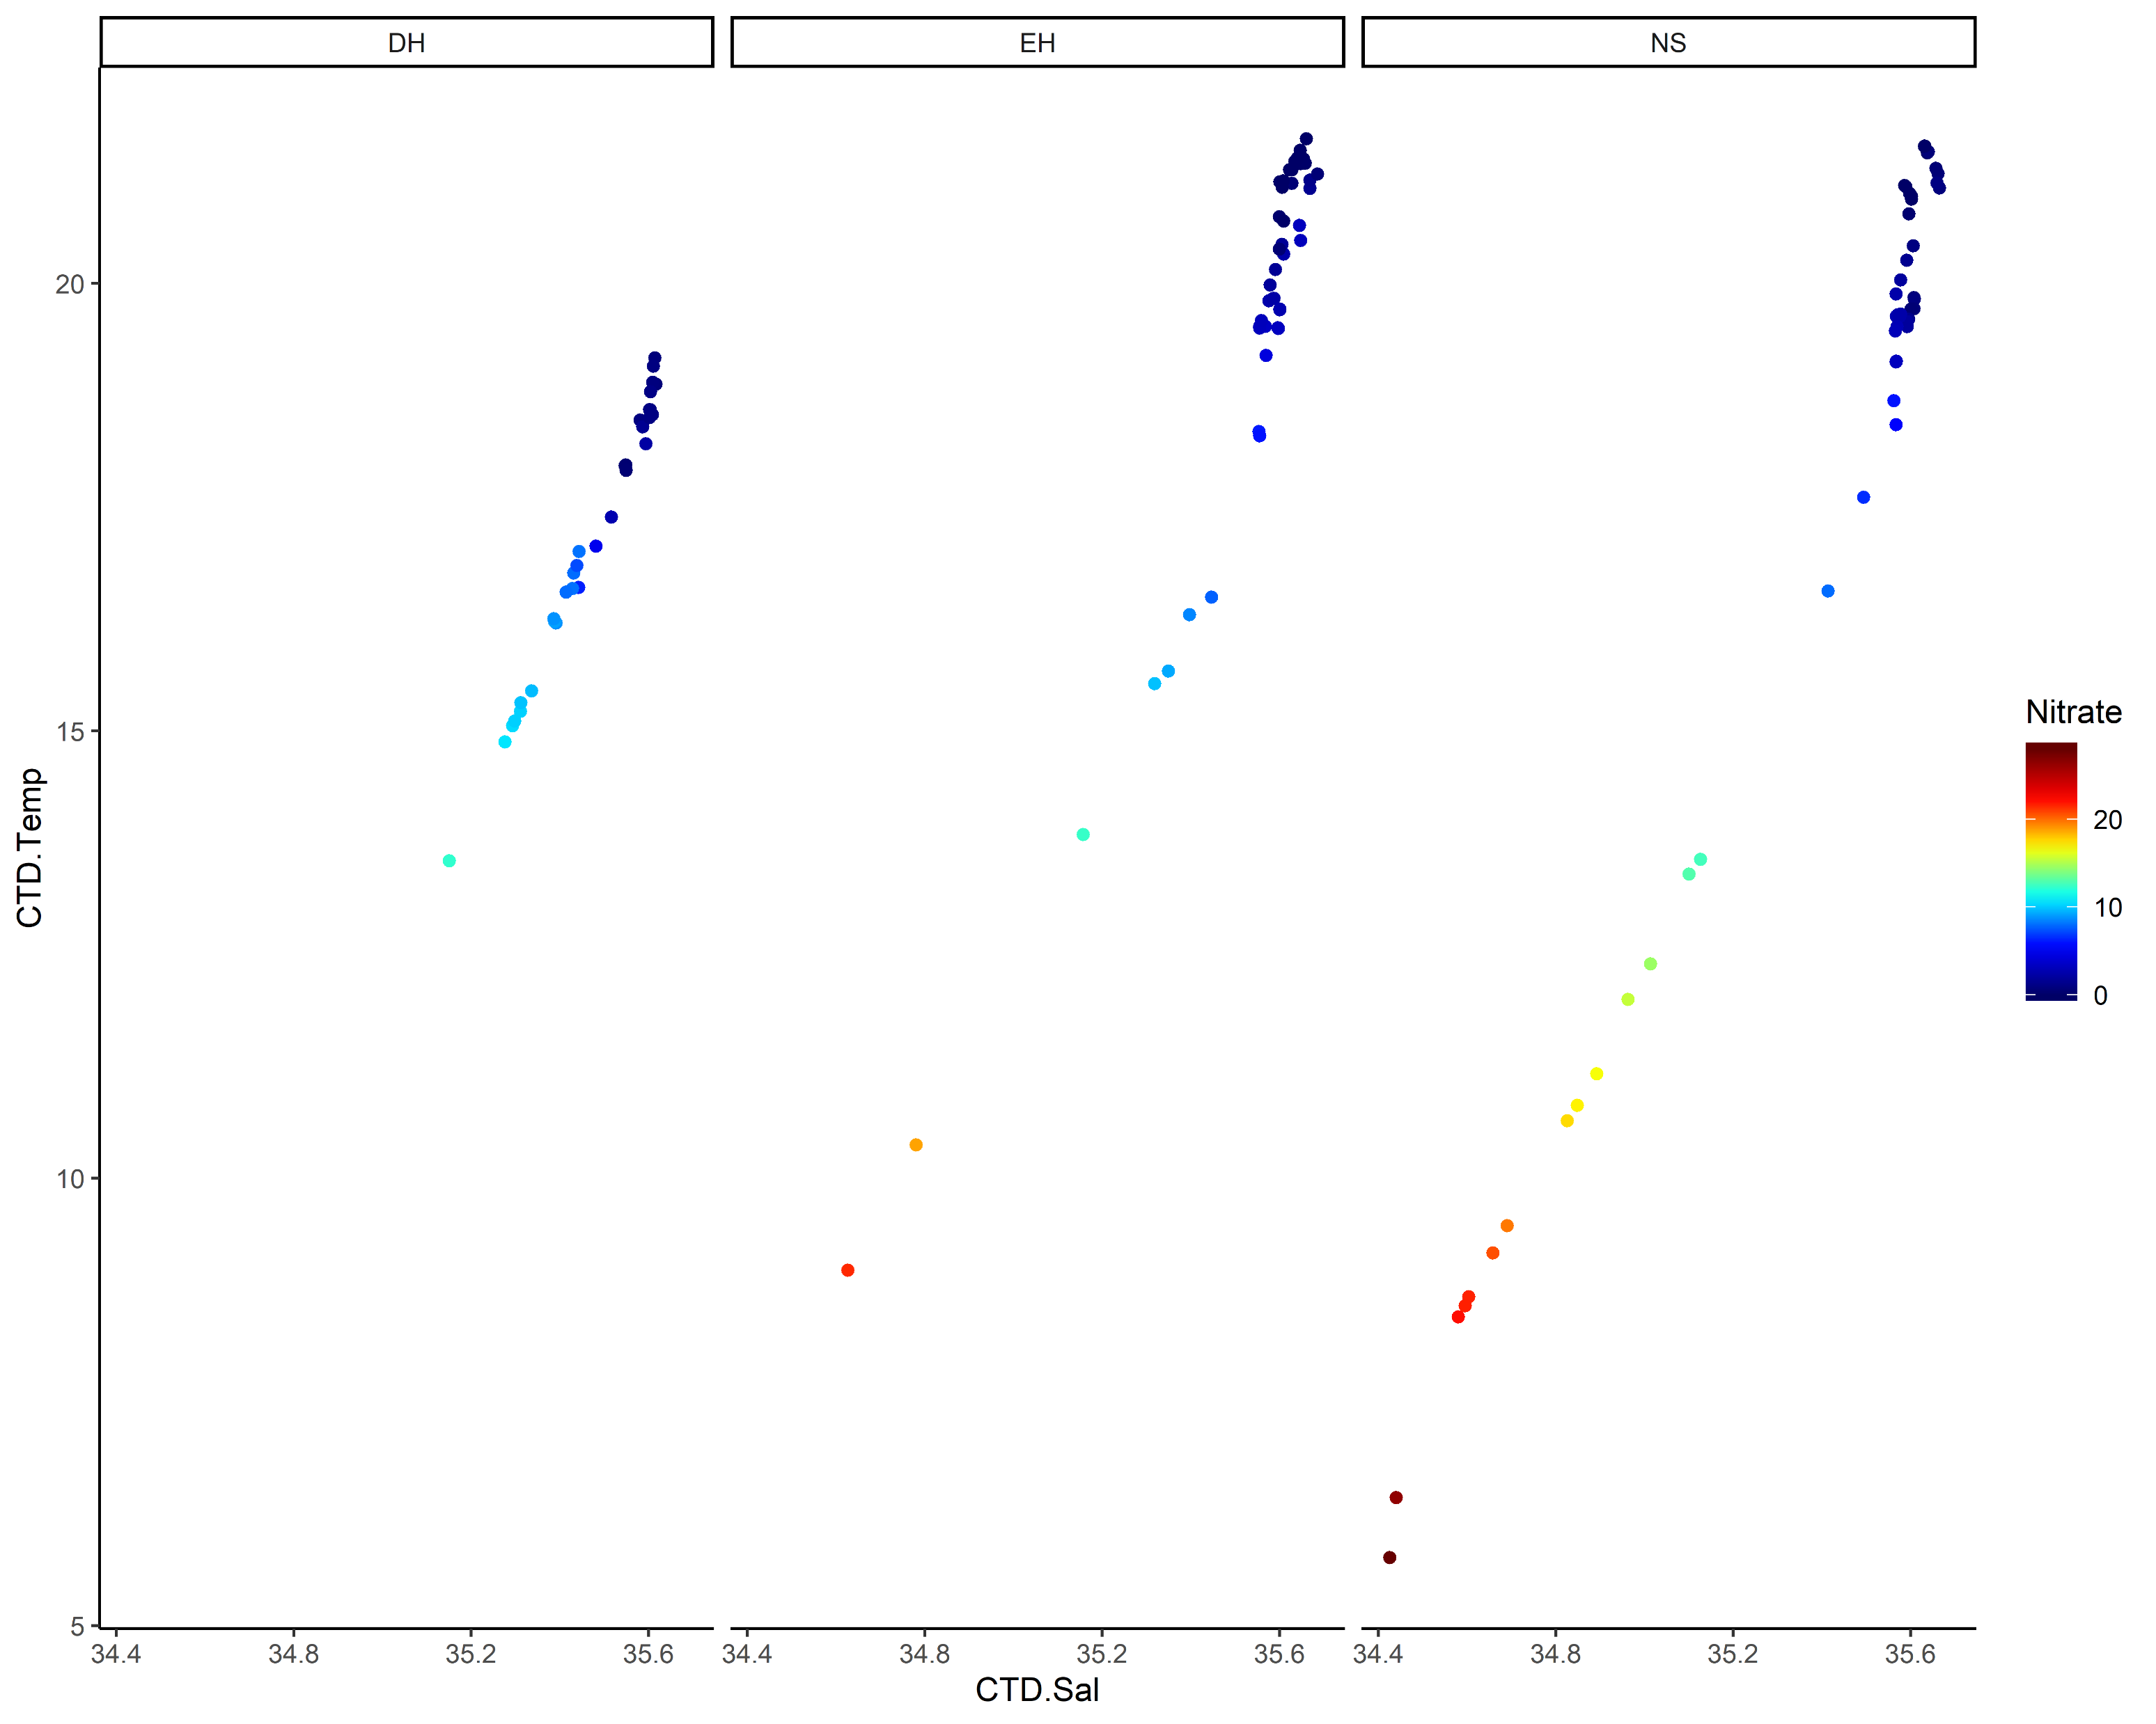
TS plot by Nitrate

Slide 32
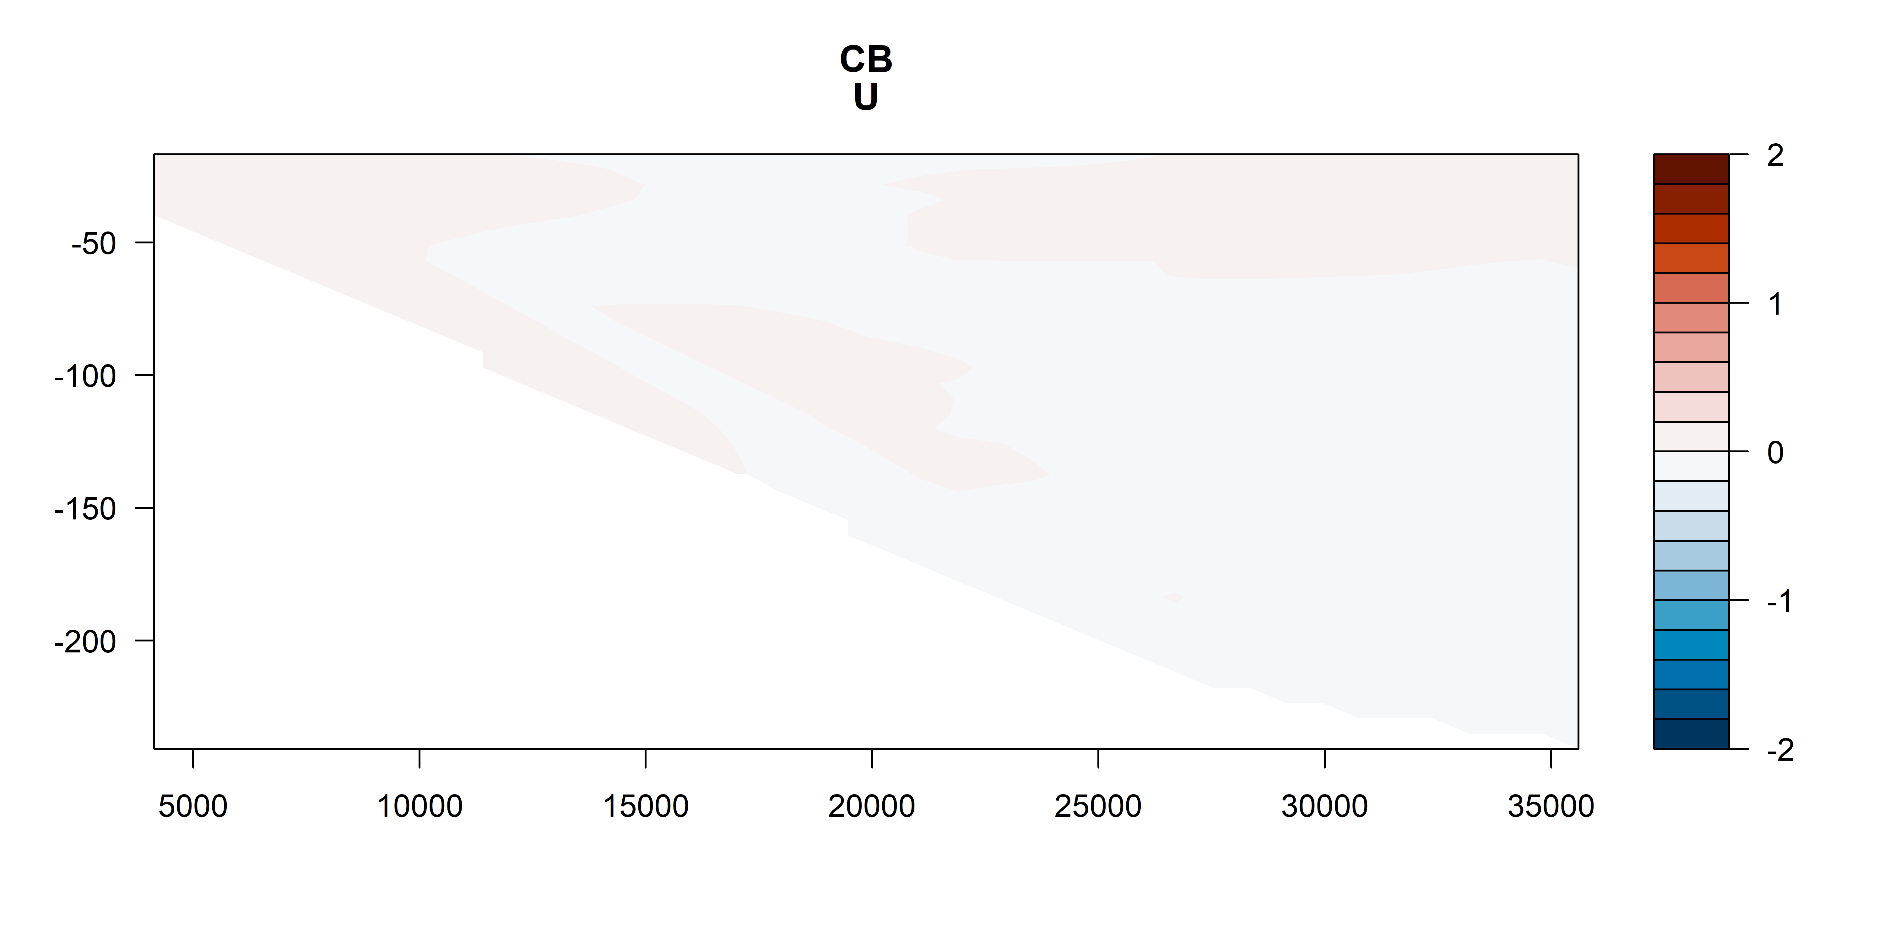
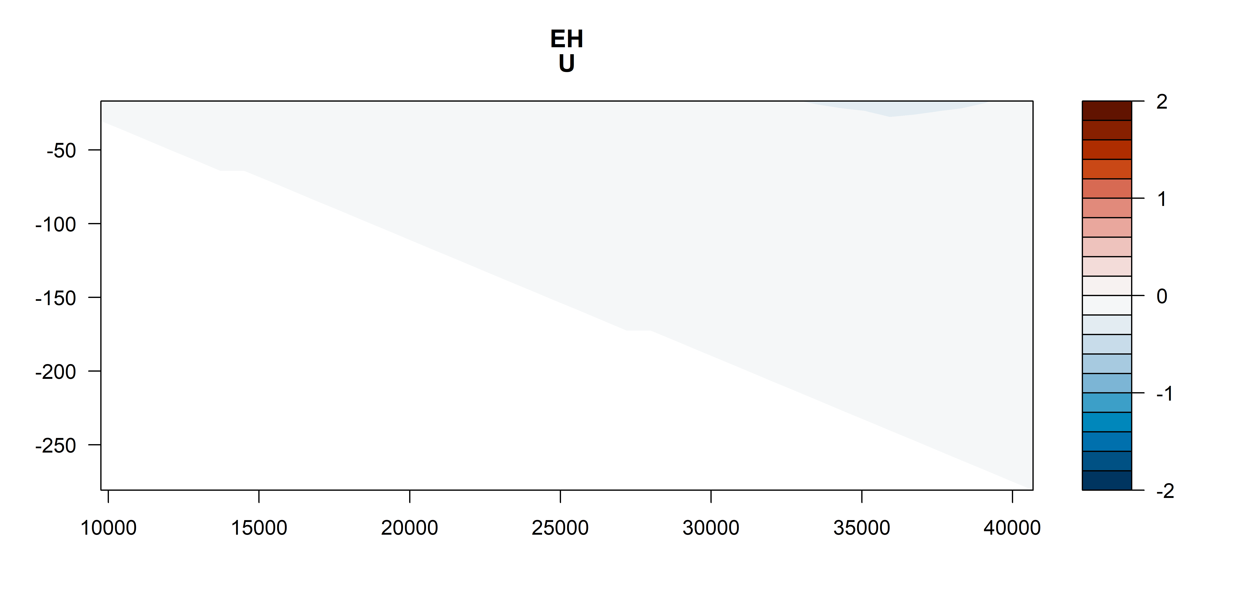
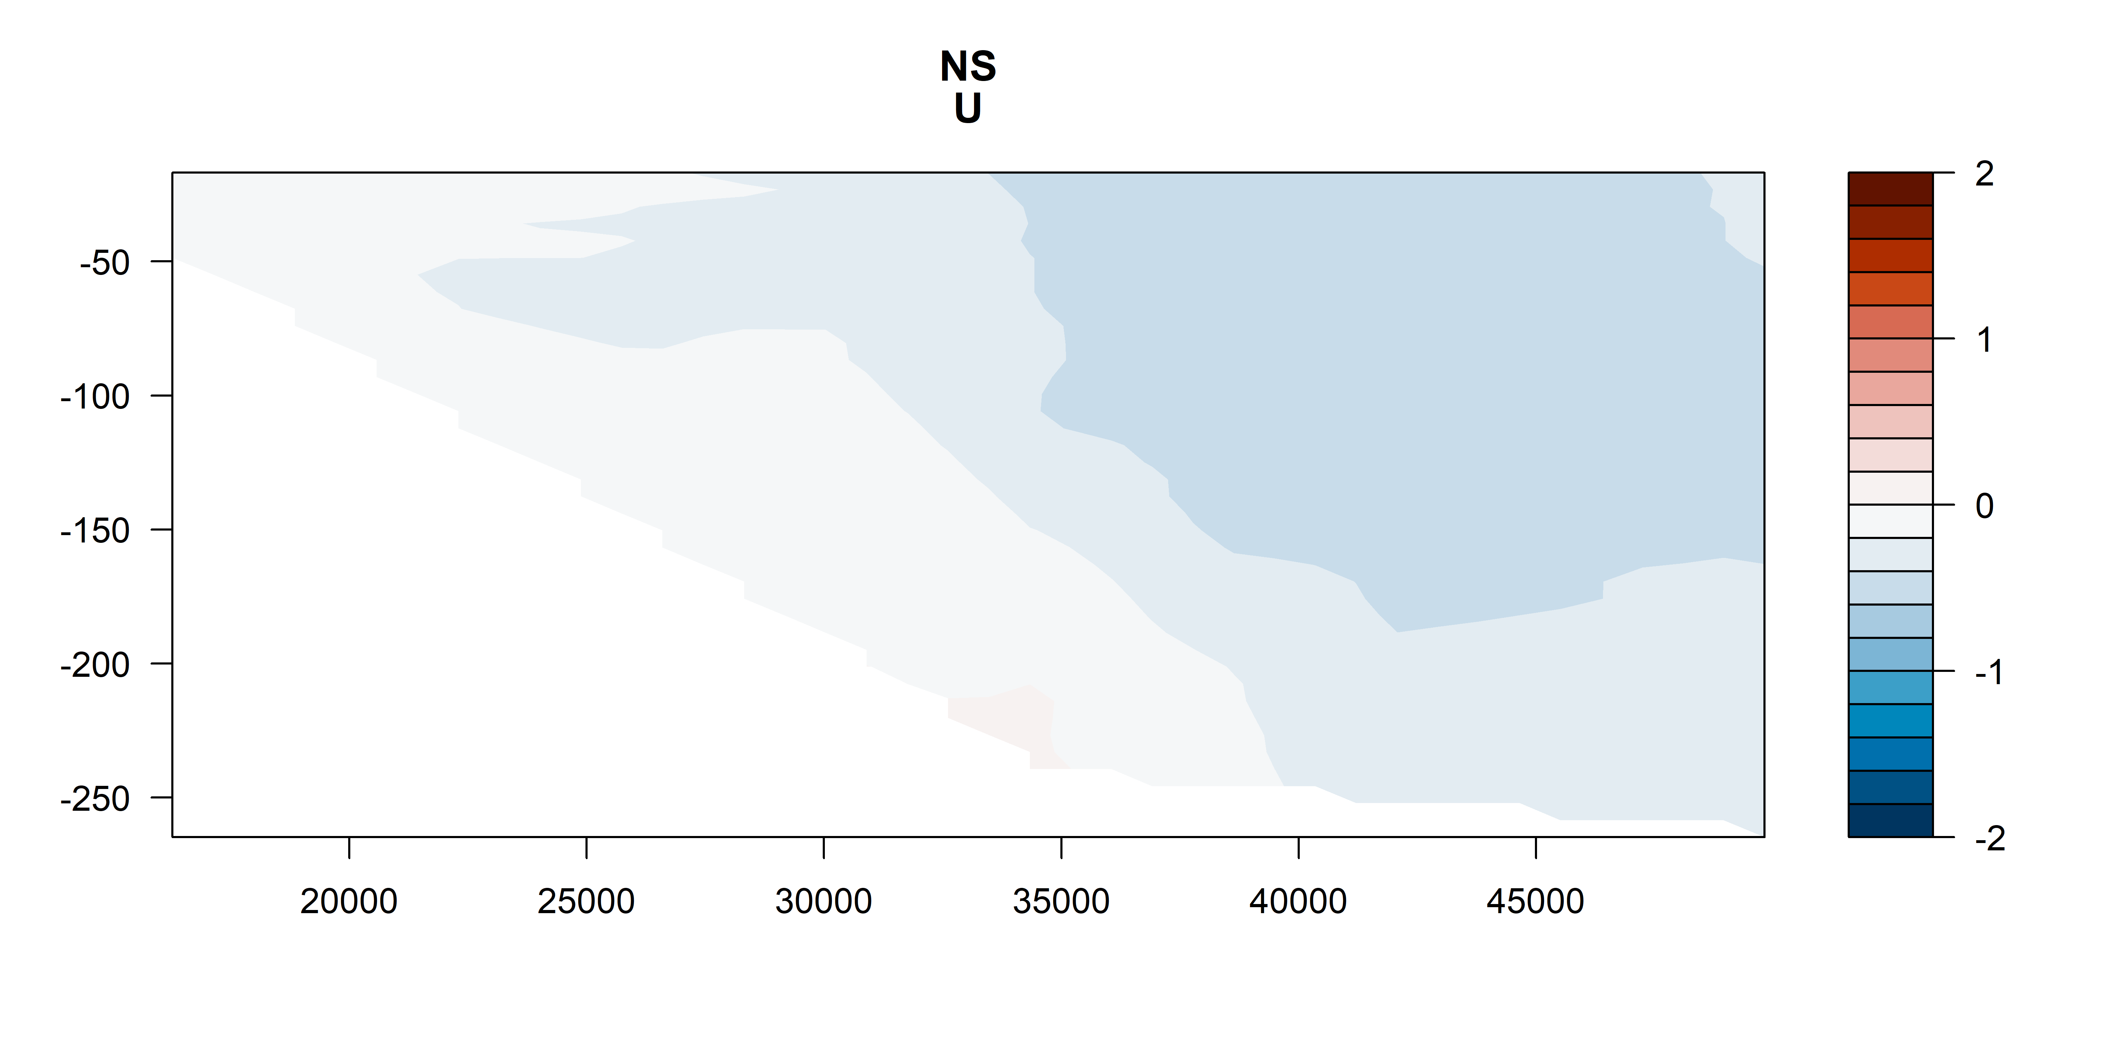
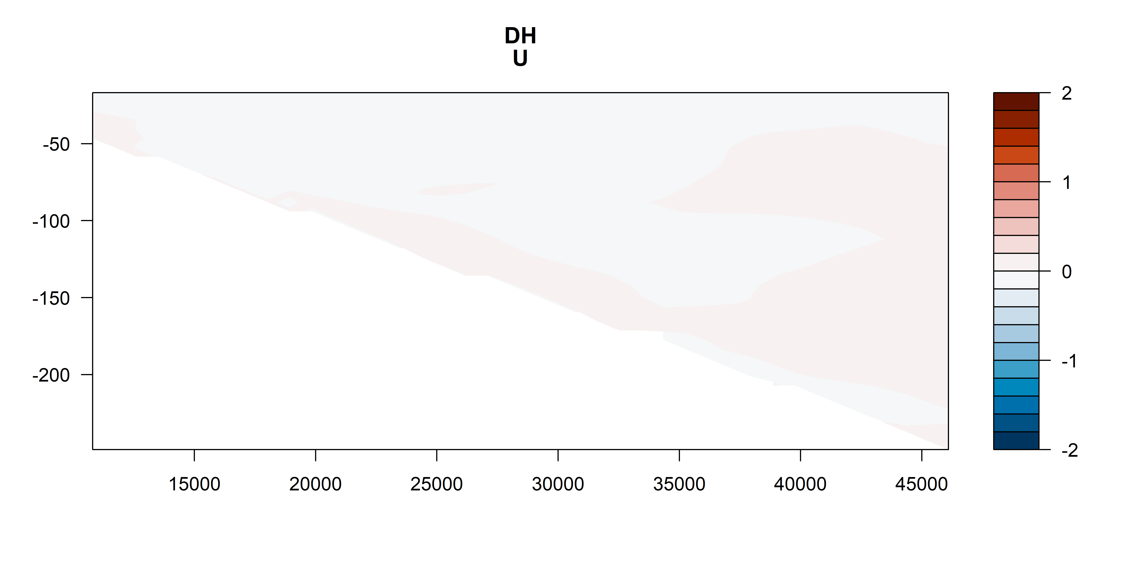
U vectors
m s⁻¹
m s⁻¹
m s⁻¹
m s⁻¹

Slide 33
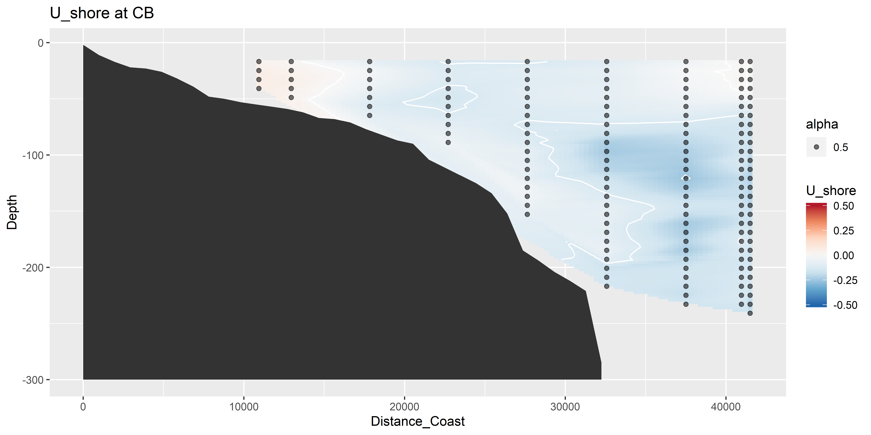
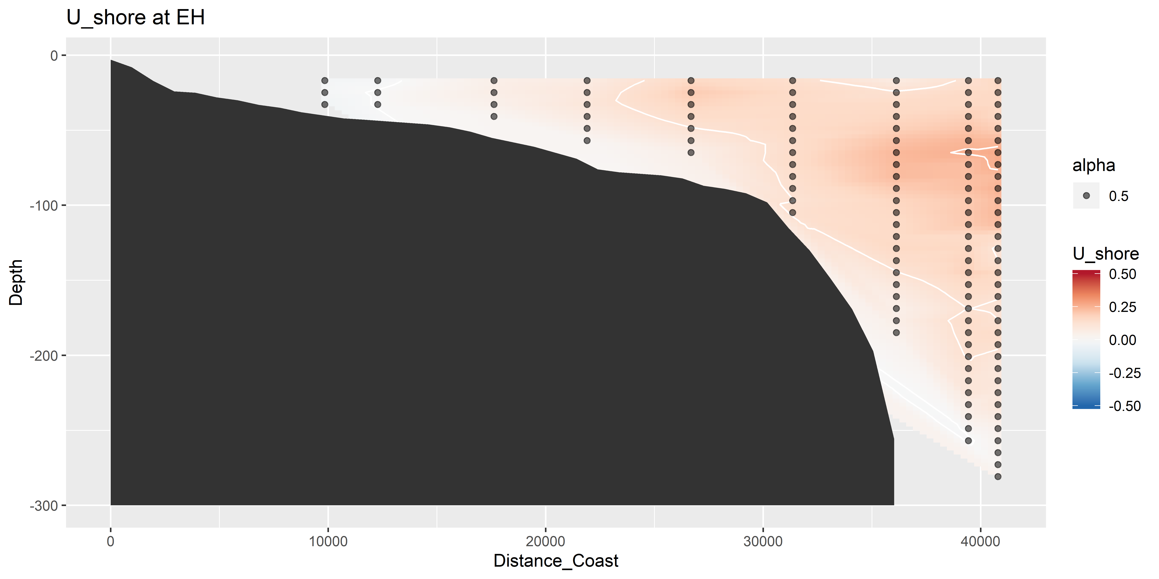
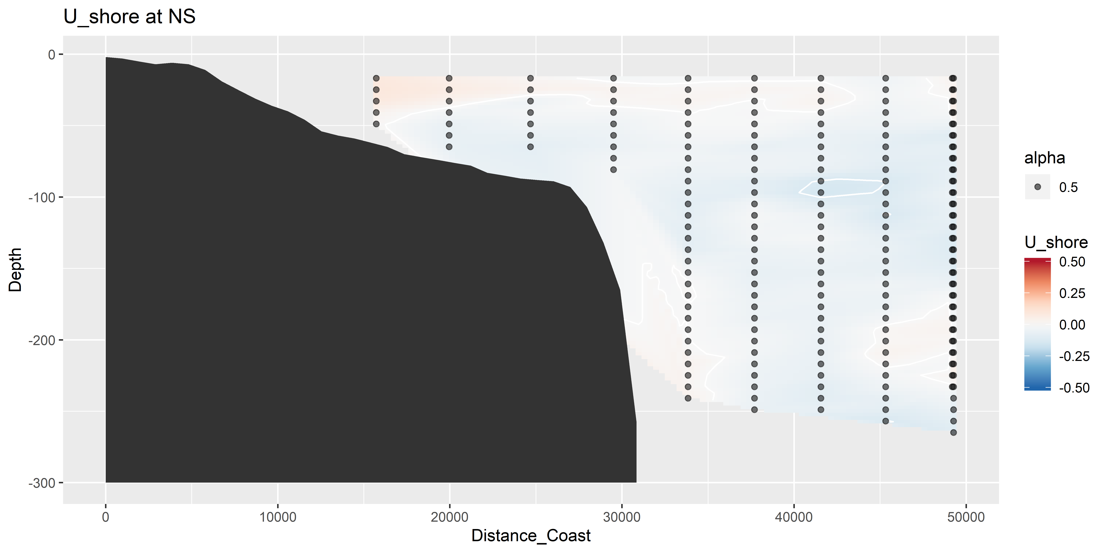
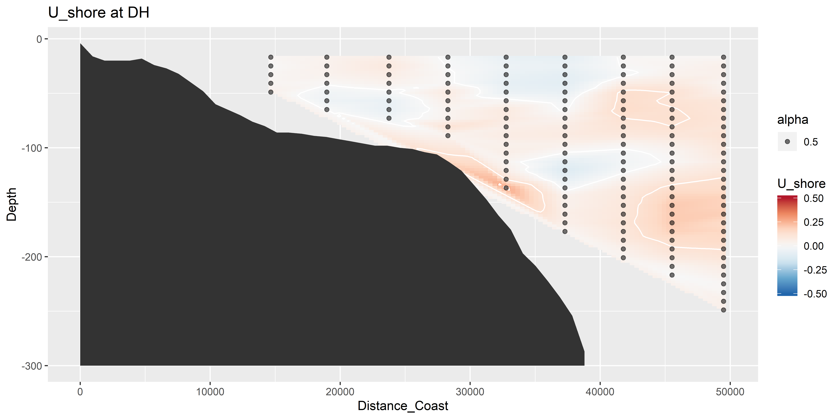
U vectors – shoreline rotated (m s⁻¹)

Slide 34
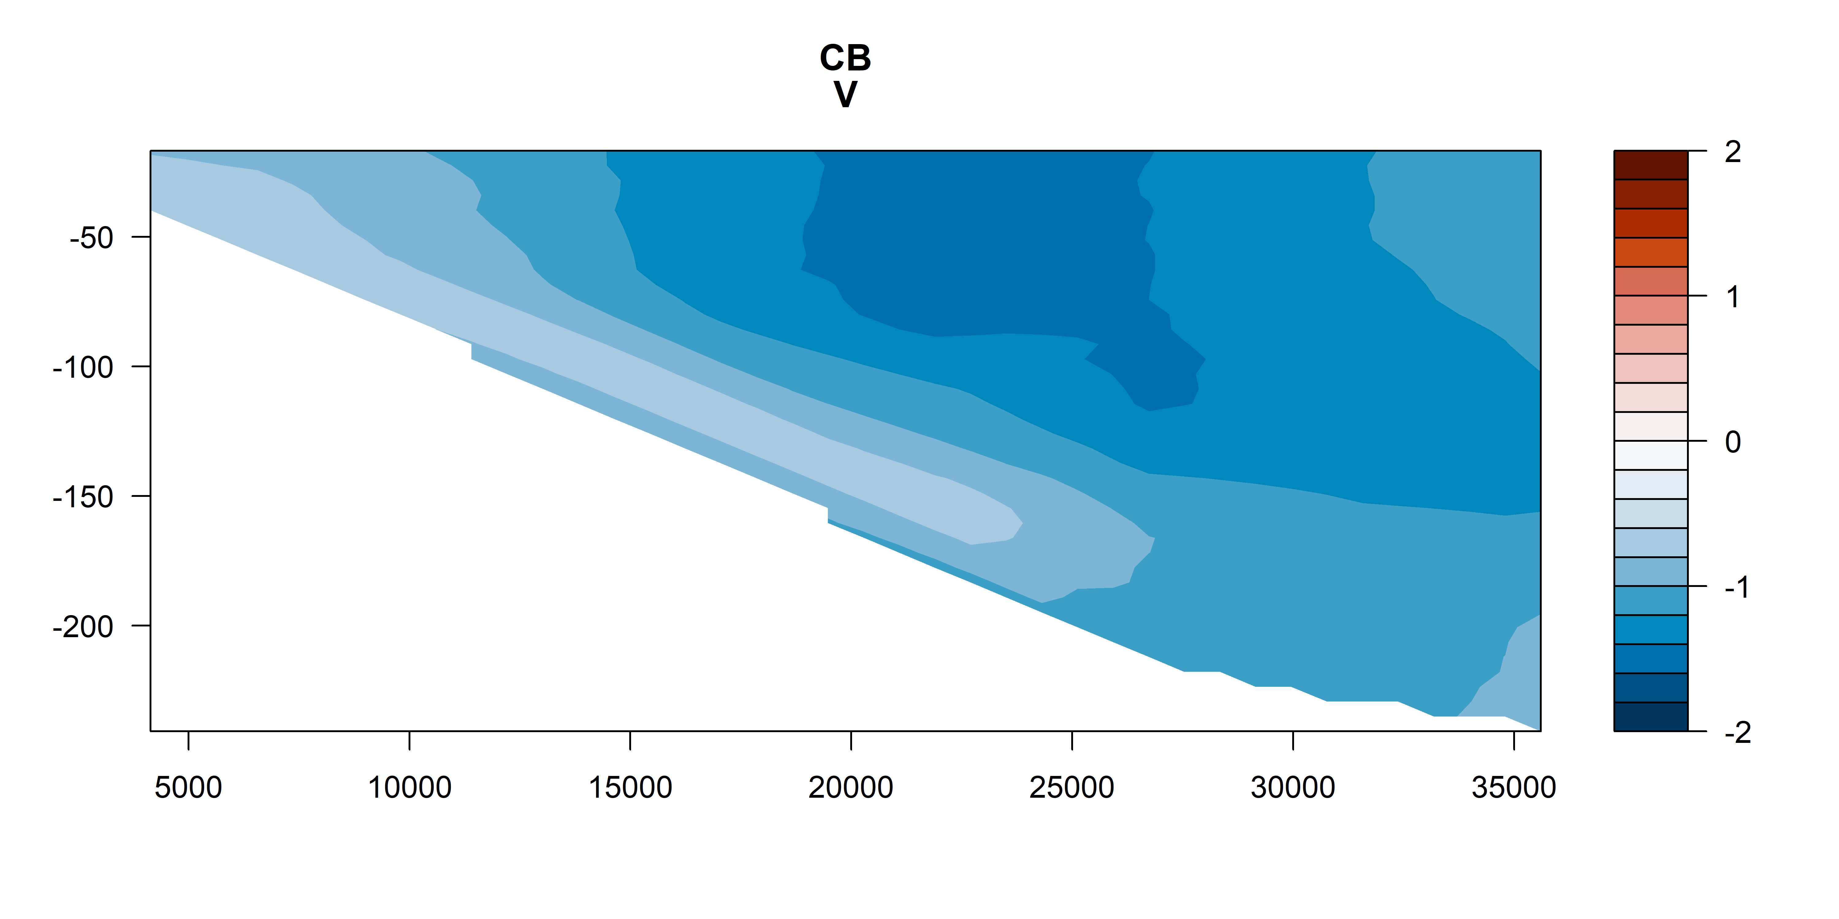
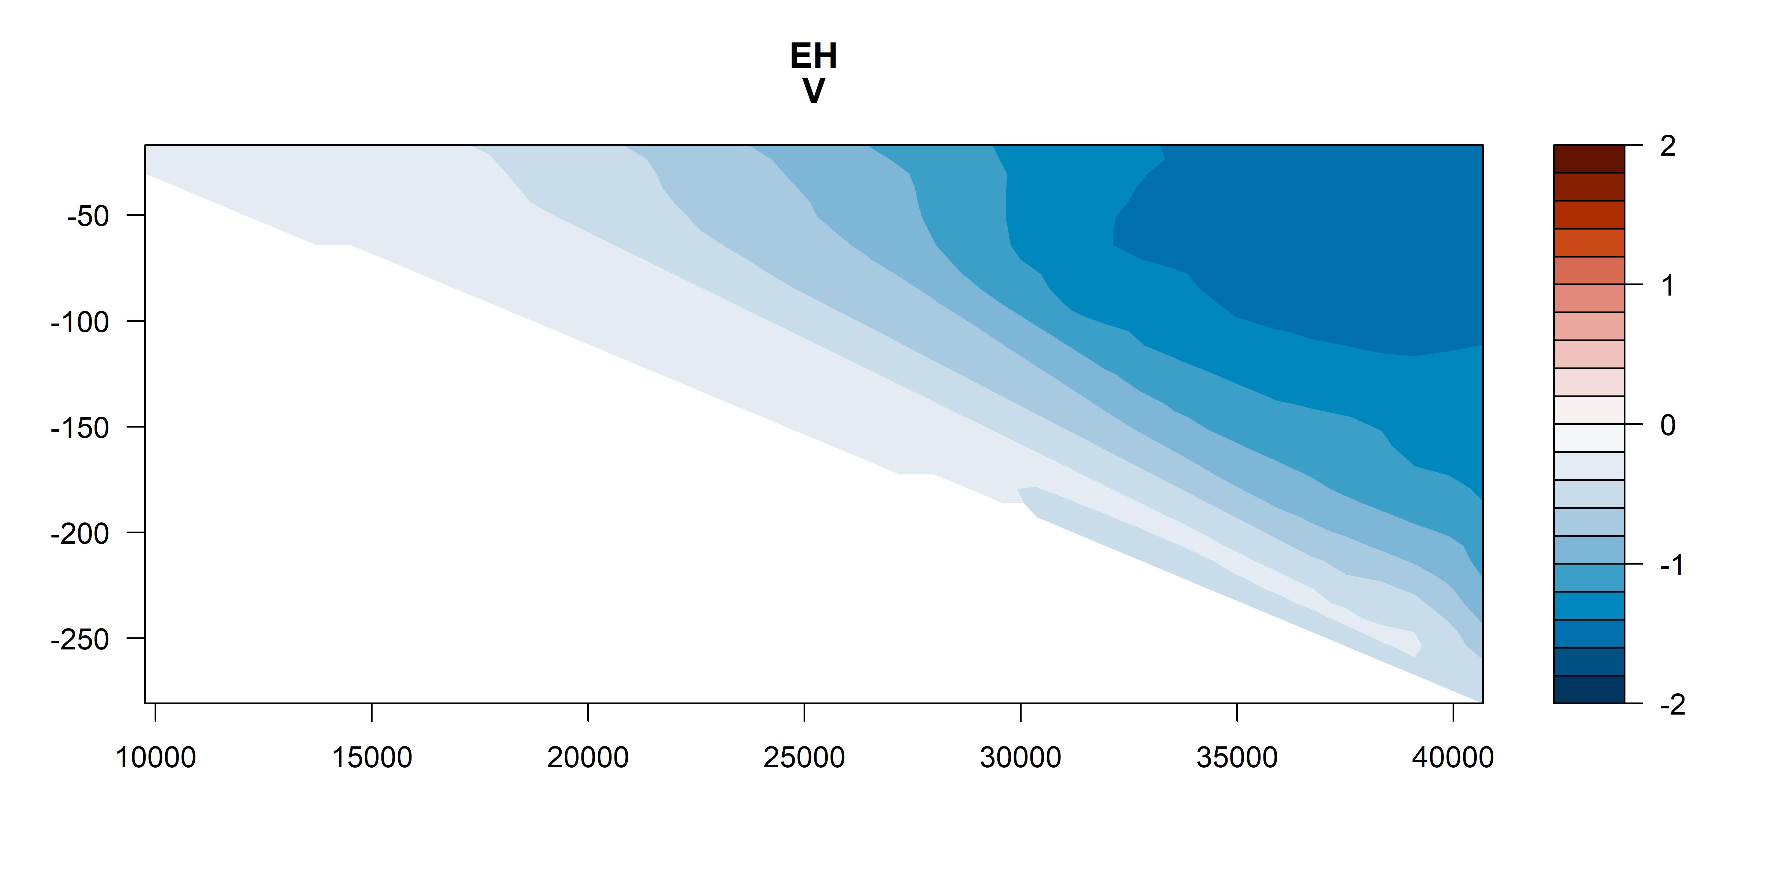
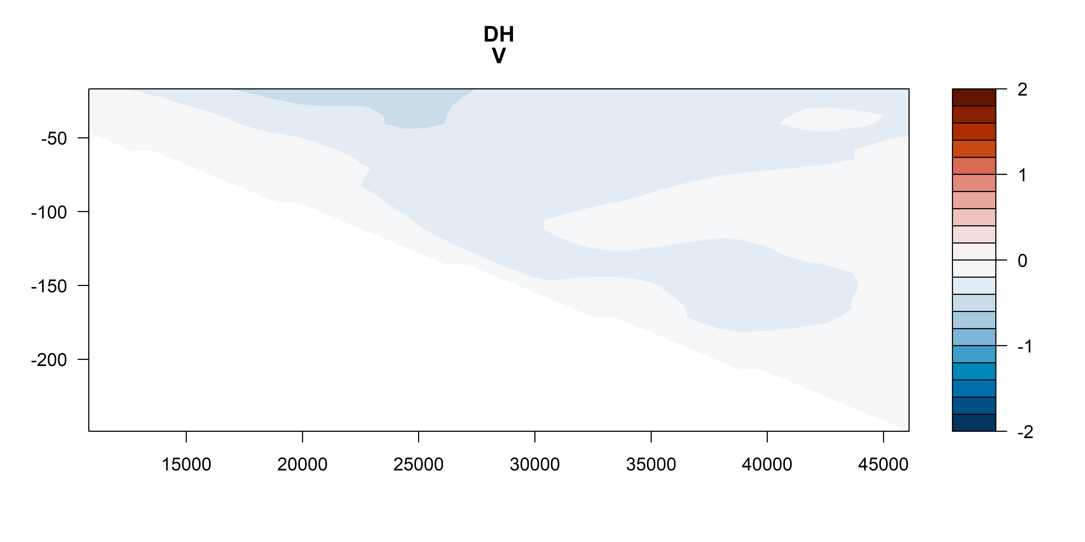
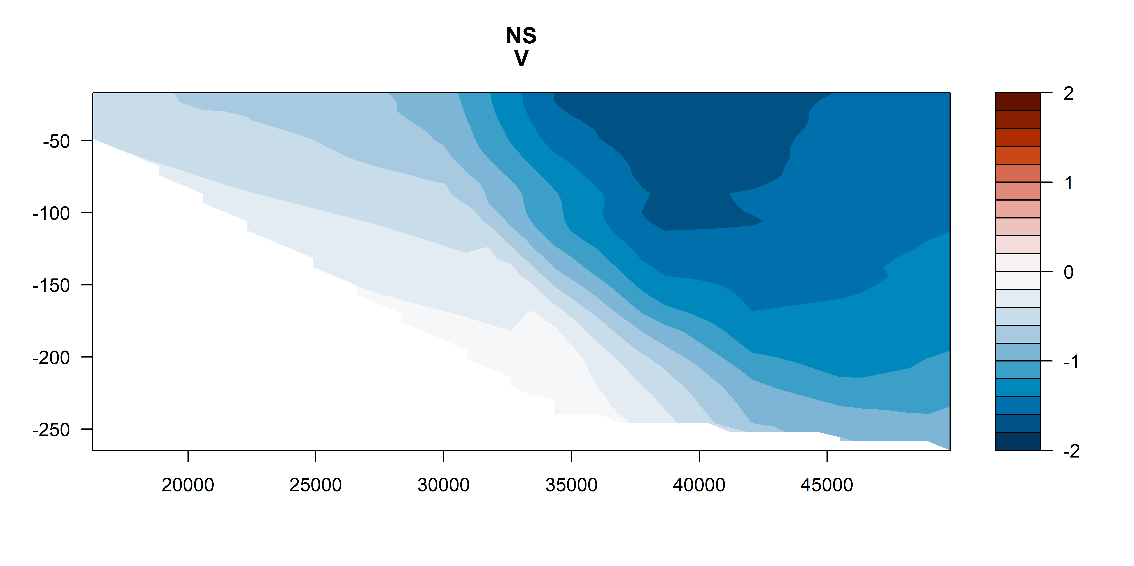
V vectors
m s⁻¹
m s⁻¹
m s⁻¹
m s⁻¹

Slide 35
V vectors – shoreline rotated (m s⁻¹)

Slide 36
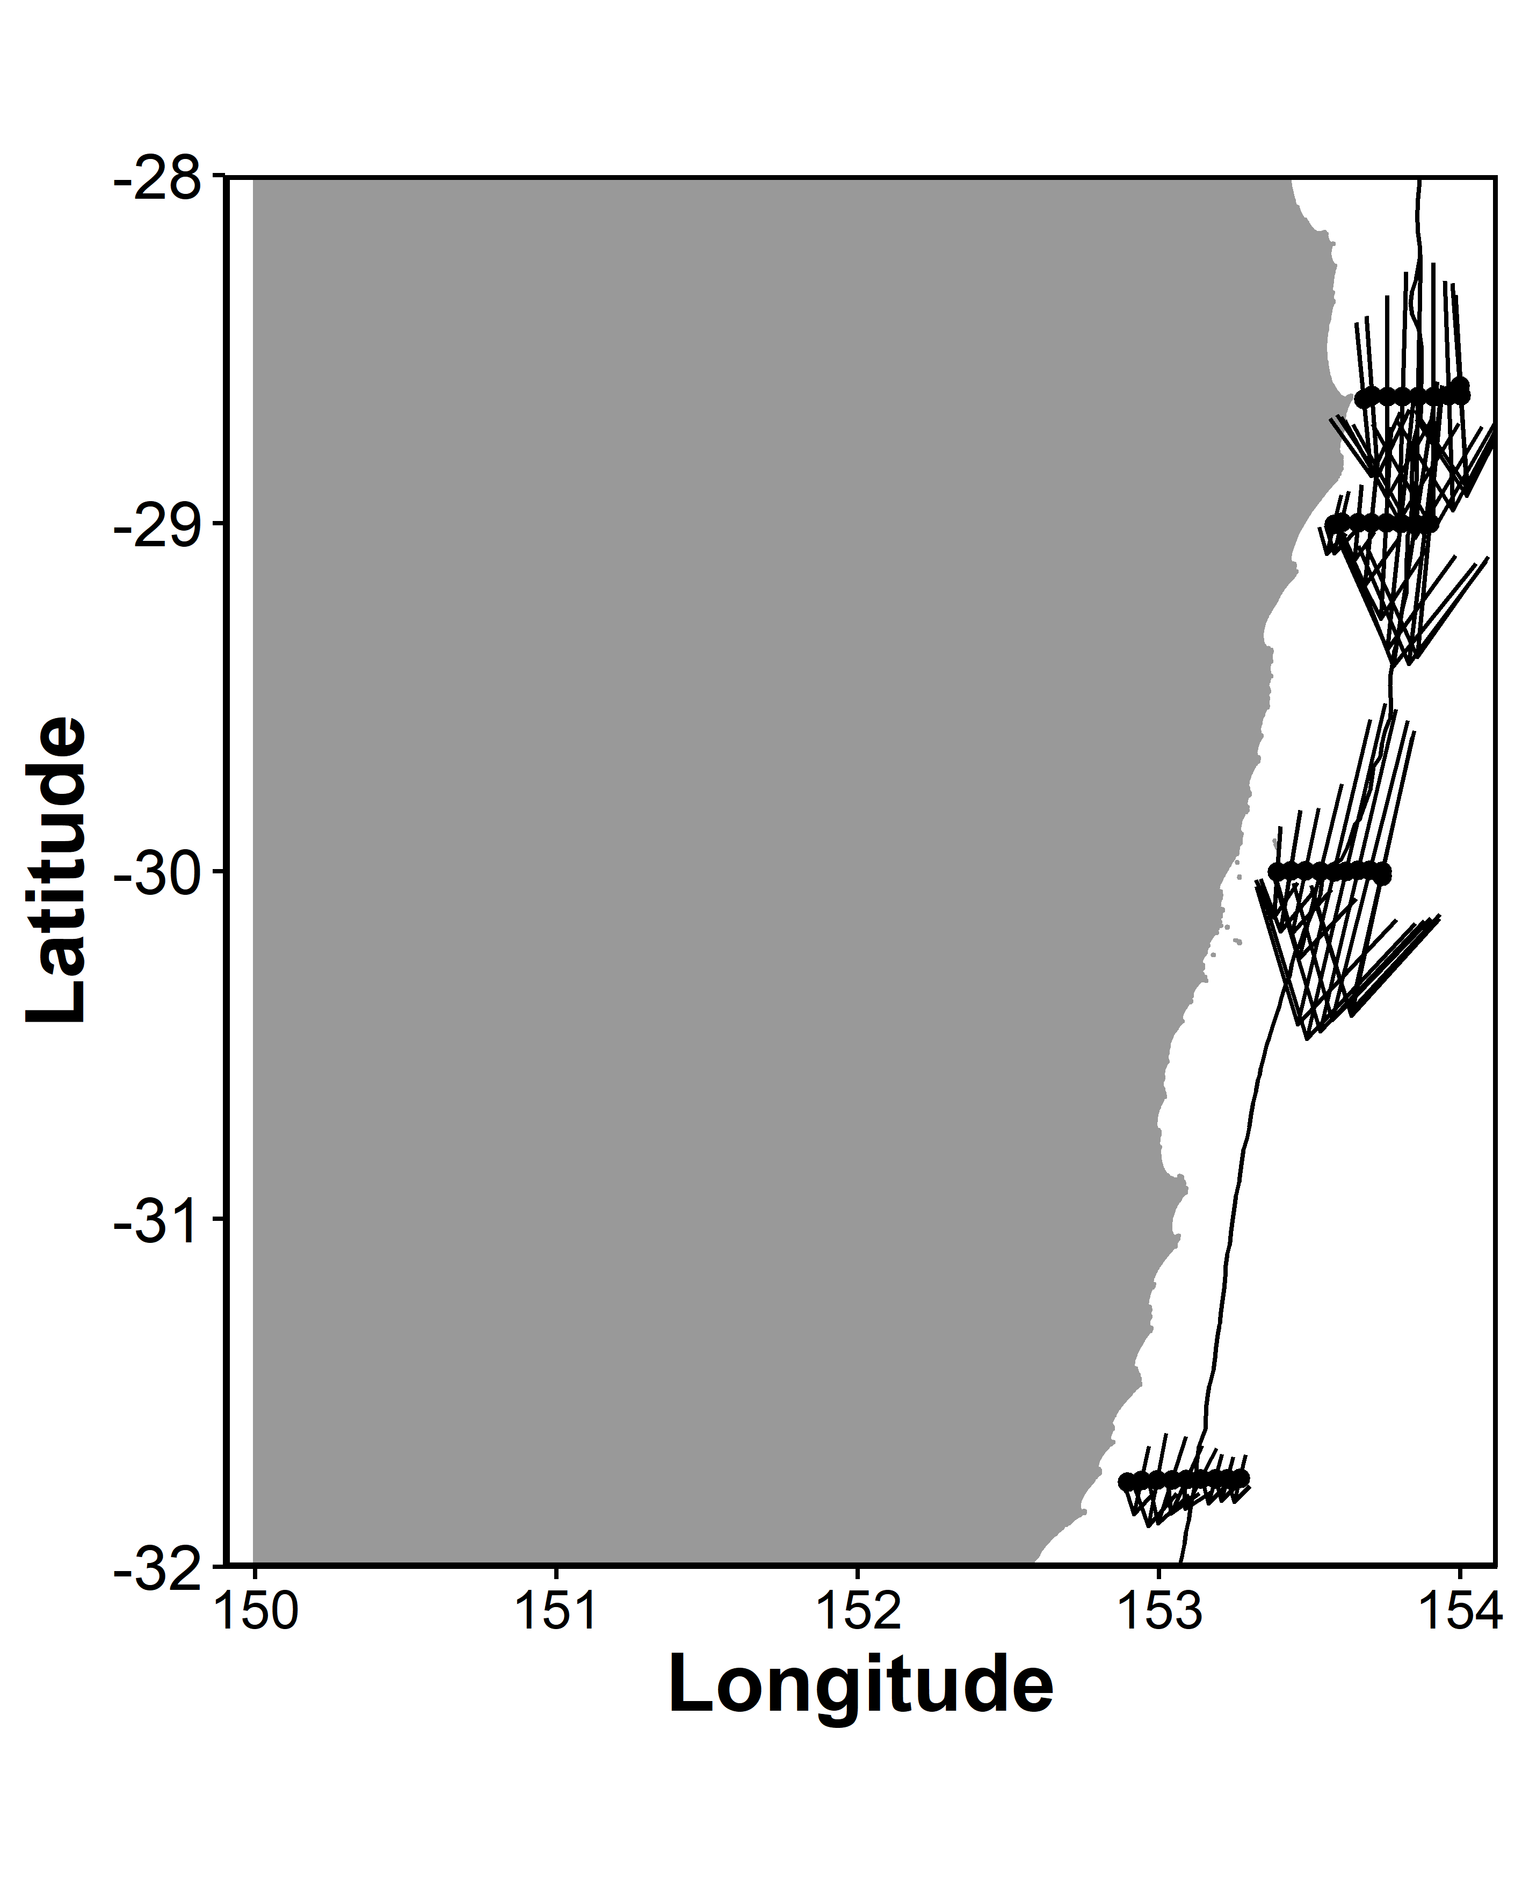
ADCP Velocity on a map

Slide 37
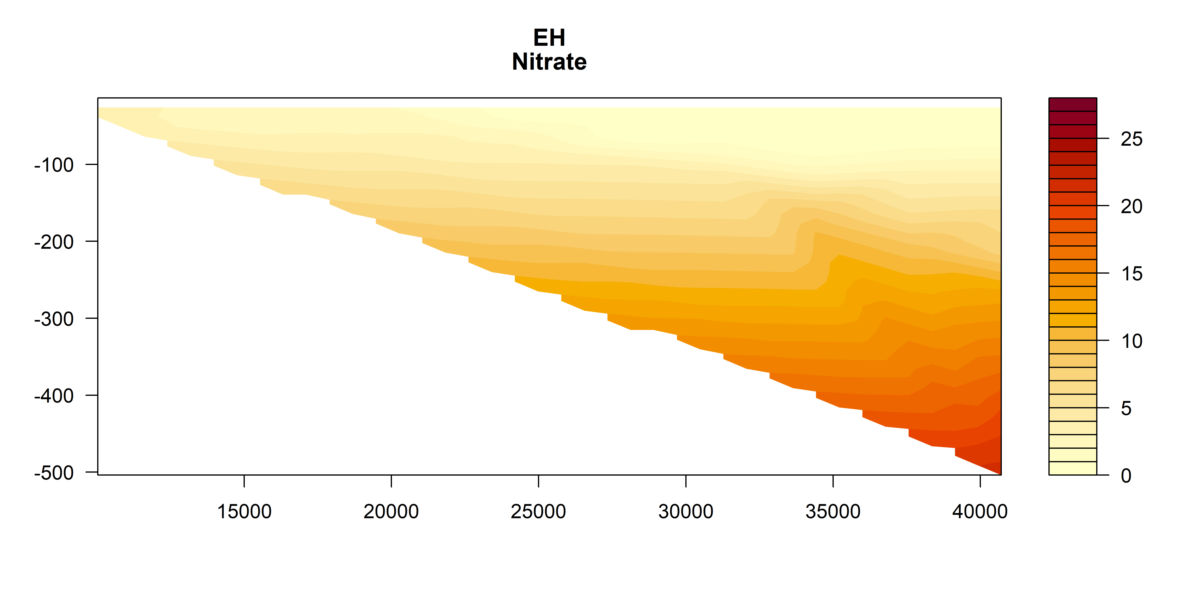


Nitrate

Slide 38



Silicate

Slide 39



Oxygen

Slide 40



Oxygen utilisation (expected – observed)
um/kg
Positive = respiration (lower O₂ than expected)
Negative = photosynthesis / production
um/kg
um/kg

Slide 41



Salinity

Slide 42



Temperature
Deg C
Deg C
Deg C

Slide 43



Chl_a

Slide 44



Chl_a top 200m

Slide 45



Nitrate

Slide 46



Silicate

Slide 47



Oxygen

Slide 48



Oxygen utilisation (top 200m)
um/kg
Positive = respiration (lower O₂)
Negative = photosynthesis / production
um/kg
um/kg

Slide 49



Salinity

Slide 50



Temperature

Slide 51

Zooplankton Biomass temperature contours

Slide 52
Zooplankton Biomass

Slide 53




NBSS Slope

Slide 54
Pareto Slope

Slide 55

Abundance

Slide 56




Abundance

Slide 57
Geometric Mean Size

Slide 58

Wind Stress

Slide 59

Modelling Zooplankton Biomass
Call: lm(formula = Biomass ~ Temp + Salt + Depth + site + Distance_Coast, data = mydata)
All variables significant except Salinity (P = 0.25)
Adj R² = 0.58
No autocorrelation taken in account ☹

Slide 60

Modelling Pareto Slope
Call: lm(formula = ParetoSlope ~ Temp + Salt + Depth + site + Distance_Coast, data = mydata)
All variables significant except Depth (P = 0.25)
Adj R² = 0.33
No autocorrelation taken in account ☹

Slide 61
Expectations
Areas of upwelling should have higher nutrients and plankton abundance
Areas offshore (open ocean water) should have slopes closer to -1
Southern sites should have higher biomass (colder water influence)

Slide 62
Patterns
Inshore North Solitary shows some upwelling + higher nutrients + biomass
North Solitary, Evans Head and Cape Byron have high surface biomass offshore (but not abundance?) – this is weird Data error
Abundance (and biomass) increases towards the shelf (I think this is common but relatively unpublished?)

